Slide 1
Formulating Algorithms, Repetition Control Statements
Java™ How to Program, Early Objects Version, 10/e

Slide 2
Outline
-.- Recall
3.7 while Repetition Statement
3.8 Formulating Algorithms: Counter-Controlled Repetition
3.9 Formulating Algorithms: Sentinel-Controlled Repetition
3.10 Formulating Algorithms: Nested Control Statements
4.2 Essentials of Counter-Controlled Repetition
4.3 for Repetition Statement
4.4 Examples Using the for Statement
4.5 do…while Repetition Statement
4.7 break and continue Statements

Slide 3
-.- Recall
Structured programming promotes simplicity.
Only three forms of control are needed to implement an algorithm:
Sequence: the sequence structure is trivial. Simply list the statements to execute in the order in which they should execute.
Selection: if, if/else, and switch
Repetition: while, for, and do/while

Slide 4
3.7 while Repetition Statement
Repetition statement—repeats an action while a condition remains true.
The repetition statement’s body may be a single statement or a block.
Eventually, the condition will become false. At this point, the repetition terminates, and the first statement after the repetition statement executes.
Example: find the first power of 3 larger than 100.
int product = 3; while (product <= 100) product = 3 * product;

Slide 5
int product = 3; while (product <= 100) product = 3 * product;
Statement | Performed Action
int product = 3; | product declared and initialized to 3
while (product <= 100) | while condition evaluated to true (3<=100)
product = 3 * product; | product value changed to 9
while (product <= 100) | condition evaluated to true (9<=100)
product = 3 * product; | product value changed to 27
while (product <= 100) | condition evaluated to true (27<=100)
product = 3 * product; | product value changed to 81
while (product <= 100) | condition evaluated to true (81<=100)
product = 3 * product; | product value changed to 243
while (product <= 100) | condition evaluated to false (243>100)
Notes:
Each iteration multiplies product by 3, so product takes on the values 9, 27, 81 and 243 successively.
When product becomes 243—product <= 100—becomes false.
Repetition terminates. The final value of product is 243.
Program execution continues with the next statement after the while statement.

Slide 6
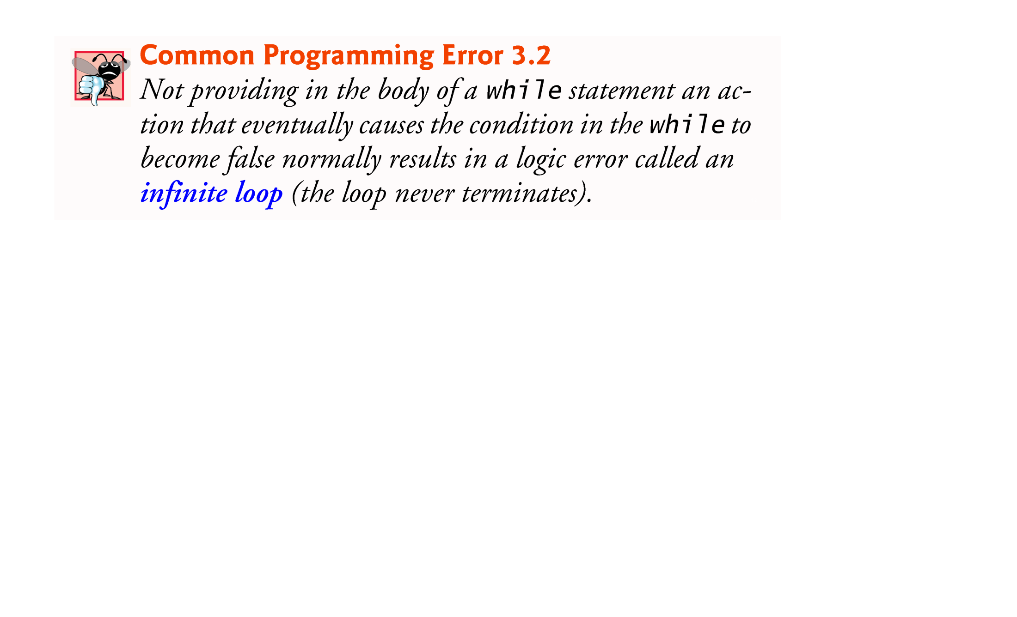

Slide 7
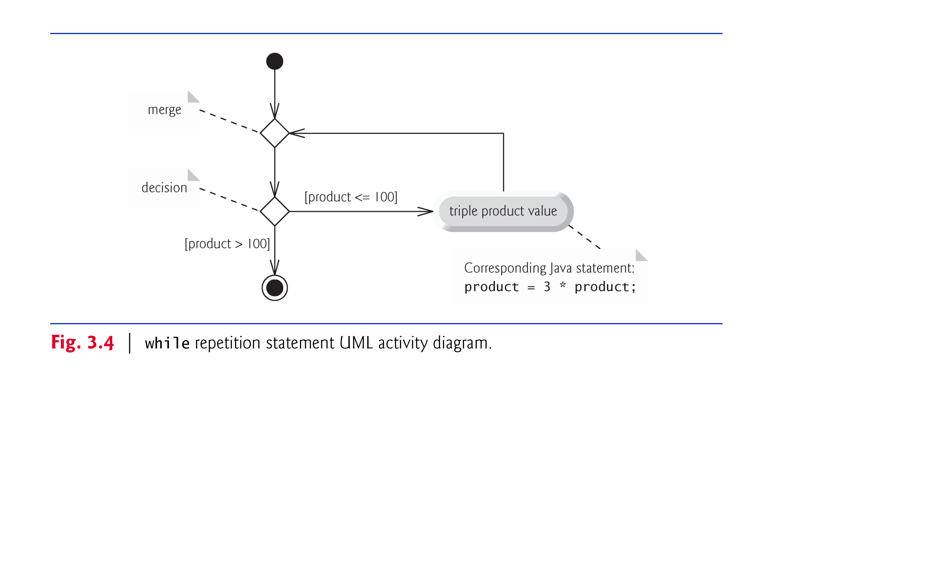
3.7 while Repetition Statement (Cont.)
while statement activity diagram .
Notes:
The UML represents both the merge symbol and the decision symbol as diamonds.
The merge symbol joins two flows of activity into one.
The decision and merge symbols can be distinguished by the number of “incoming” and “outgoing” transition arrows.
A decision symbol has one transition arrow pointing to the diamond and two or more pointing out from it to indicate possible transitions from that point. Each transition arrow pointing out of a decision symbol has a guard condition next to it.
A merge symbol has two or more transition arrows pointing to the diamond and only one pointing from the diamond, to indicate multiple activity flows merging to continue the activity. None of the transition arrows associated with a merge symbol has a guard condition.

Slide 8
3.8 Formulating Algorithms: Counter-Controlled Repetition
A class of ten students took a quiz. The grades (integers in the range 0 to 100) for this quiz are available to you. Determine the class average on the quiz.
The class average is equal to the sum of the grades divided by the number of students.
The algorithm for solving this problem on a computer must input each grade, keep track of the total of all grades input, perform the averaging calculation and print the result.
Use counter-controlled repetition to input the grades one at a time.
A variable called a counter (or control variable) controls the number of times a set of statements will execute.
Counter-controlled repetition is often called definite repetition, because the number of repetitions is known before the loop begins executing.

Slide 9
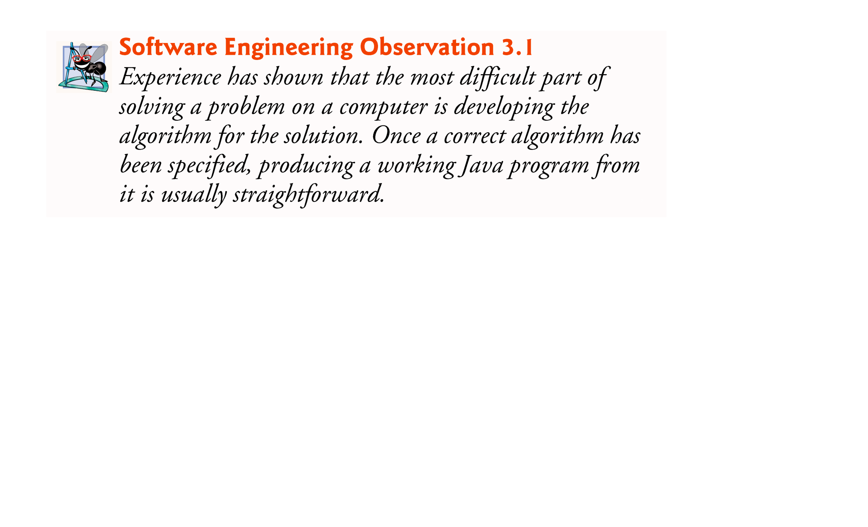

Slide 10
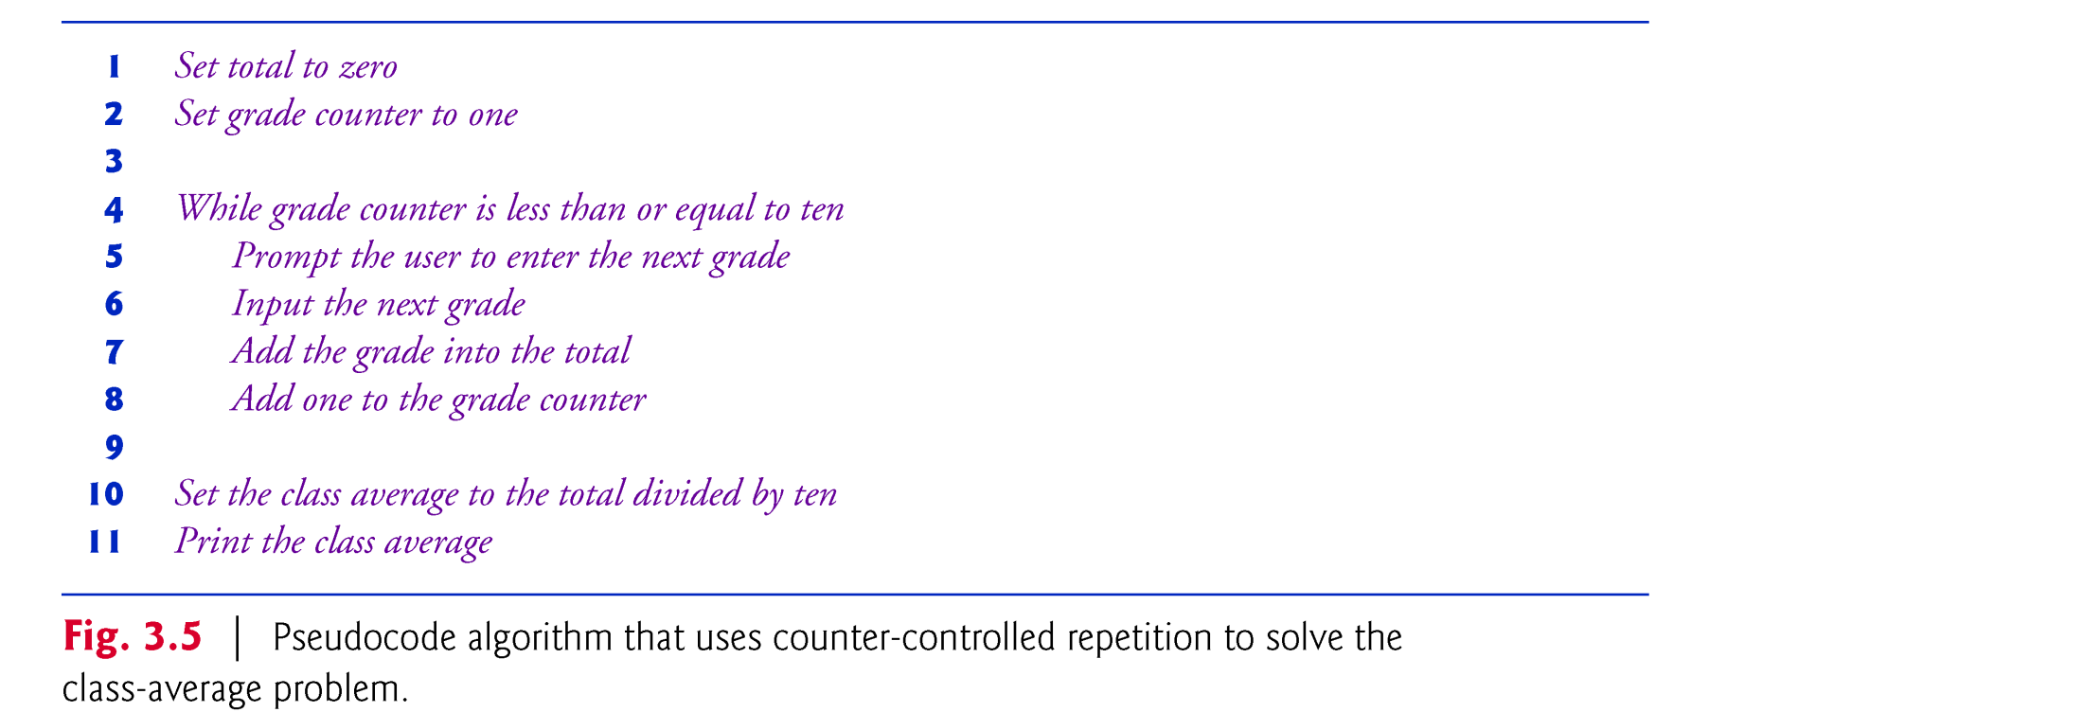
3.8 Formulating Algorithms: Counter-Controlled Repetition (Cont.)
A total is a variable used to accumulate the sum of several values.
A counter is a variable used to count.
Variables used to store totals are normally initialized to zero before being used in a program.

Slide 11
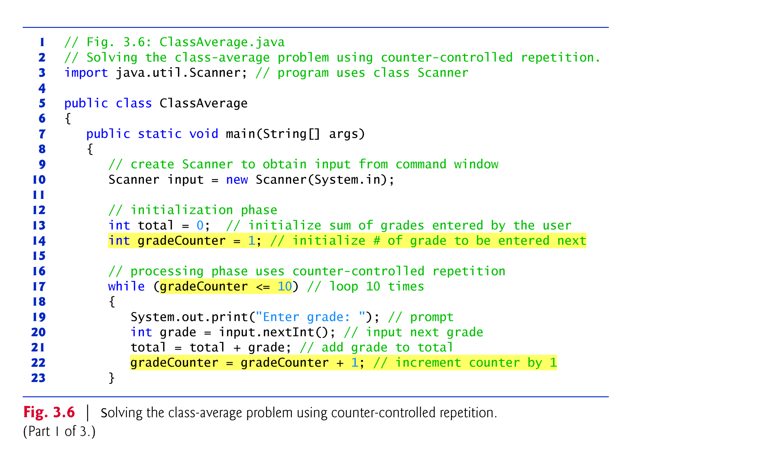

Slide 12
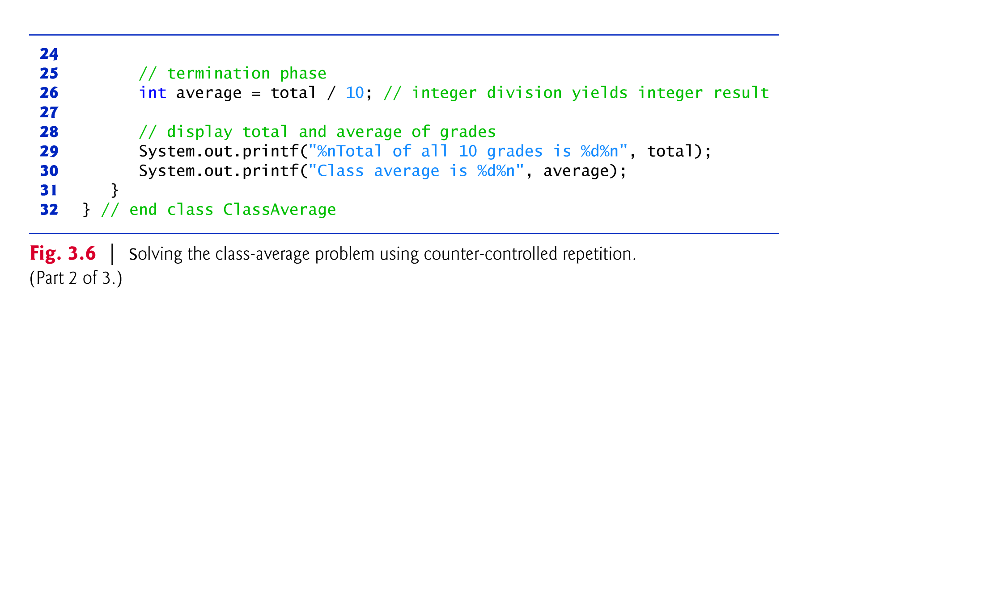
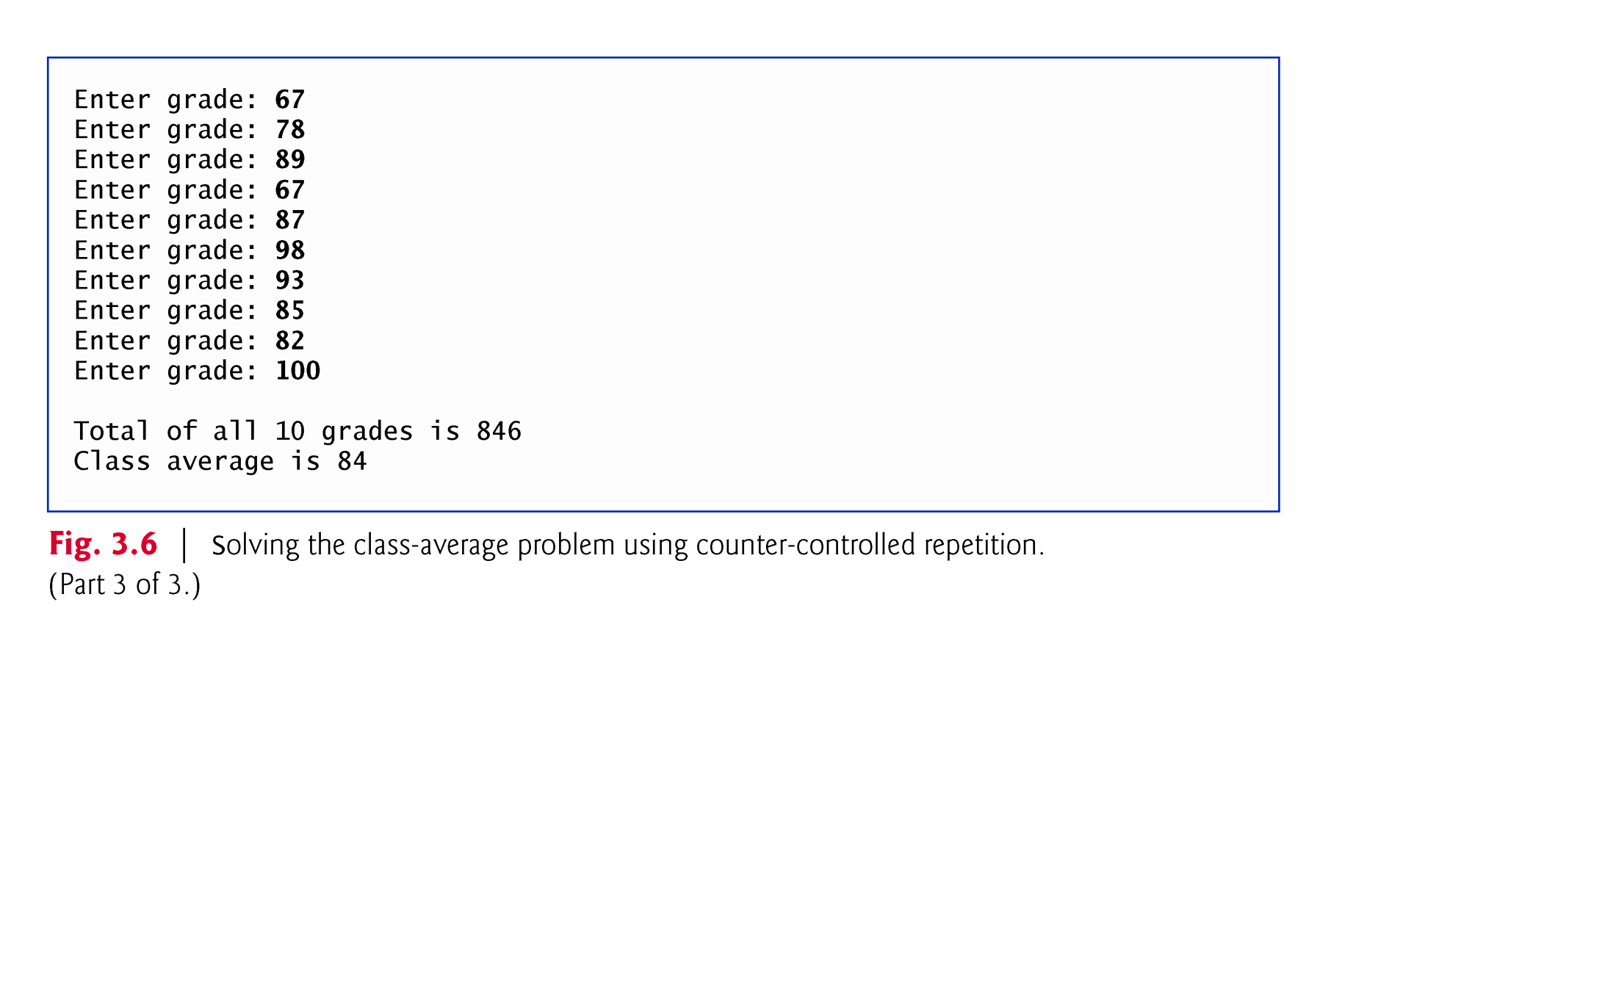

Slide 13
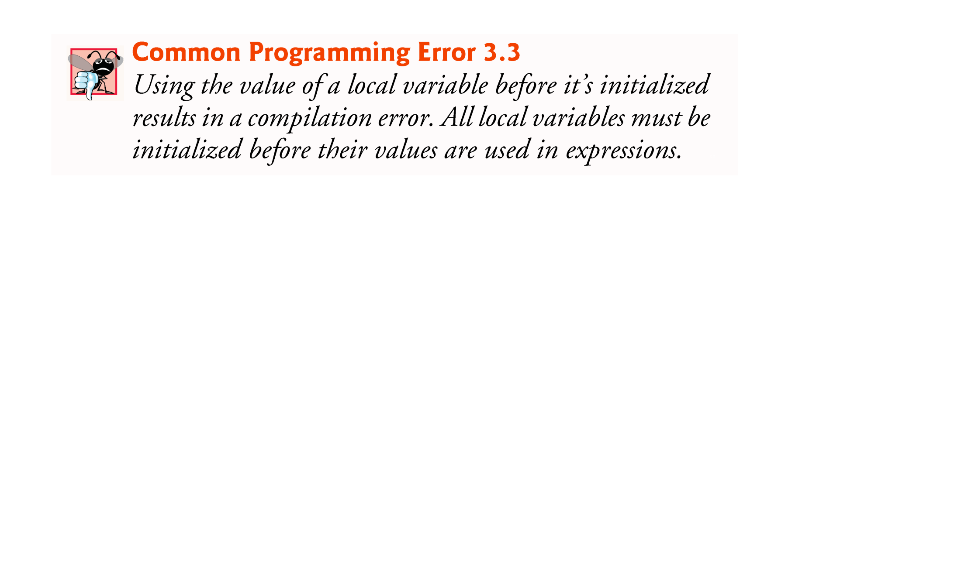
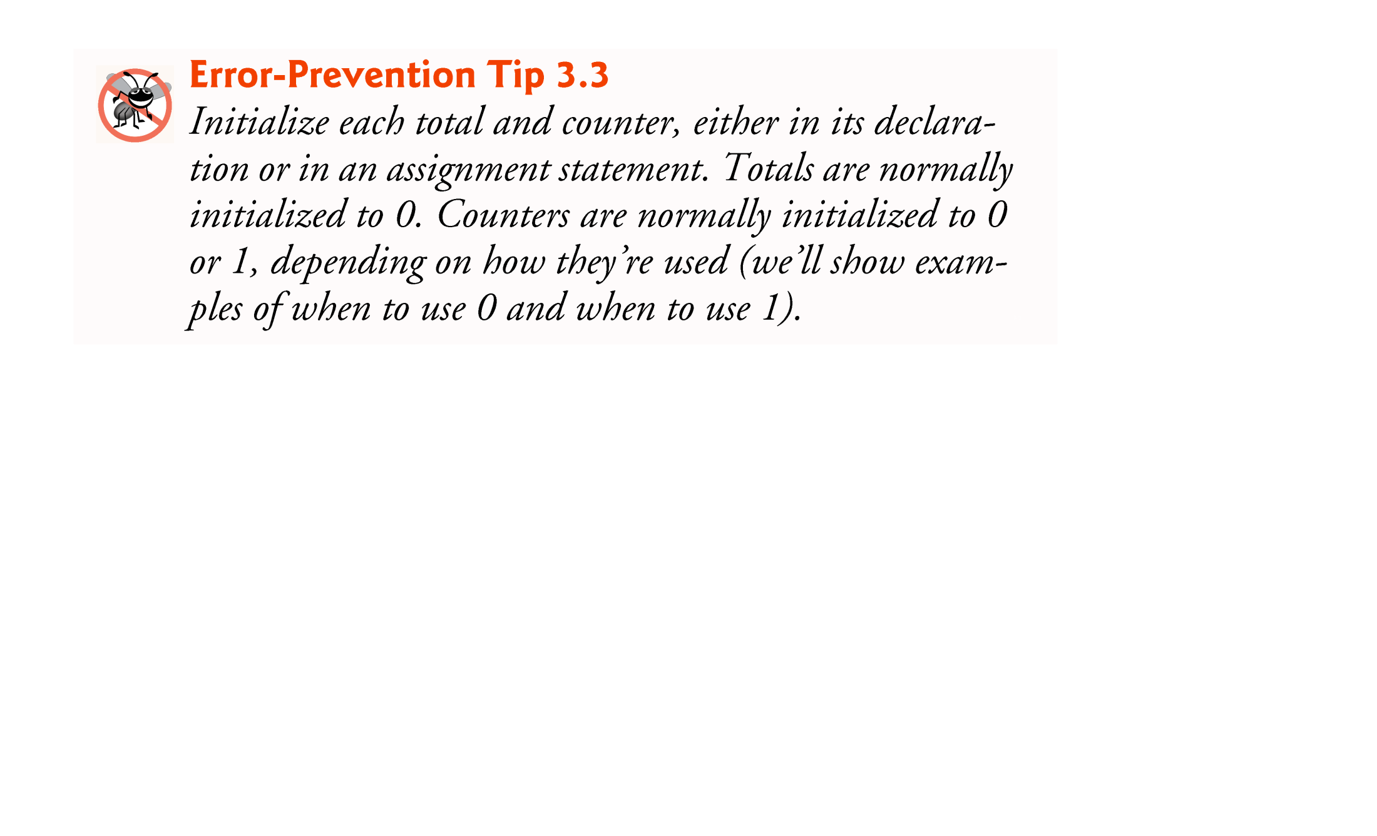
3.8 Formulating Algorithms: Counter-Controlled Repetition (Cont.)
A local variable’s declaration must appear before the variable is used in the program.

Slide 14
3.8 Formulating Algorithms: Counter-Controlled Repetition (Cont.)
The program’s output indicates that the sum of the grade values in the sample execution is 846, which, when divided by 10, should yield the floating-point number 84.6.
The result of the calculation total / 10 is the integer 84, because total and 10 are both integers.
Dividing two integers results in integer division—any fractional part of the calculation is truncated (i.e., lost).

Slide 15
3.8 Formulating Algorithms: Counter-Controlled Repetition (Cont.)
In Fig. 3.6, line 21
total = total + grade; // add grade to total
added each grade entered by the user to the total.
This simple statement has a potential problem—adding the integers could result in a value that’s too large to store in an int variable.
This is known as arithmetic overflow and causes undefined behavior, which can lead to unintended results.

Slide 16
3.8 Formulating Algorithms: Counter-Controlled Repetition (Cont.)
The maximum and minimum values that can be stored in an int variable are represented by the constants MIN_VALUE and MAX_VALUE, respectively, which are defined in class Integer.
There are similar constants for the other integral types and for floating-point types.
Each primitive type has a corresponding class type in package java.lang.

Slide 17
3.8 Formulating Algorithms: Counter-Controlled Repetition (Cont.)
Any time a program receives input from the user, various problems might occur.
For example,
// input next grade
int grade = input.nextInt();
we assume that the user will enter an integer grade in the range 0 to 100.
However, the person entering a grade could enter an integer less than 0, an integer greater than 100, an integer outside the range of values that can be stored in an int variable, a number containing a decimal point or a value containing letters or special symbols that’s not even an integer.

Slide 18
3.8 Formulating Algorithms: Counter-Controlled Repetition (Cont.)
To ensure that inputs are valid, industrial-strength programs must test for all possible erroneous cases.
A program that inputs grades should validate the grades by using range checking to ensure that they are values from 0 to 100.
You can then ask the user to reenter any value that’s out of range.

Slide 19
3.9 Formulating Algorithms: Sentinel-Controlled Repetition
Develop a class-averaging program that processes grades for an arbitrary number of students each time it’s run.
Sentinel-controlled repetition is often called indefinite repetition because the number of repetitions is not known before the loop begins executing.
A special value called a sentinel value (also called a signal value, a dummy value or a flag value) can be used to indicate “end of data entry.”
A sentinel value must be chosen that cannot be confused with an acceptable input value.

Slide 20
3.9 Formulating Algorithms: Sentinel-Controlled Repetition (Cont.)
Top-down, stepwise refinement
Begin with a pseudocode representation of the top—a single statement that conveys the overall function of the program:
Determine the class average for the quiz
The top is a complete representation of a program. Rarely conveys sufficient detail from which to write a Java program.
Divide the top into a series of smaller tasks and list these in the order in which they’ll be performed.
First refinement:
Initialize variables Input, sum and count the quiz grades Calculate and print the class average
This refinement uses only the sequence structure—the steps listed should execute in order, one after the other.

Slide 21
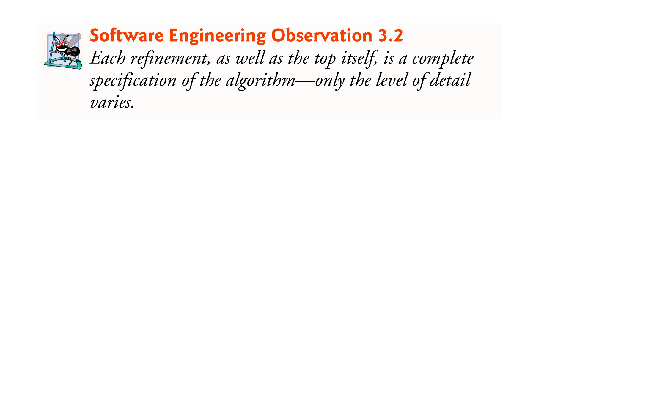
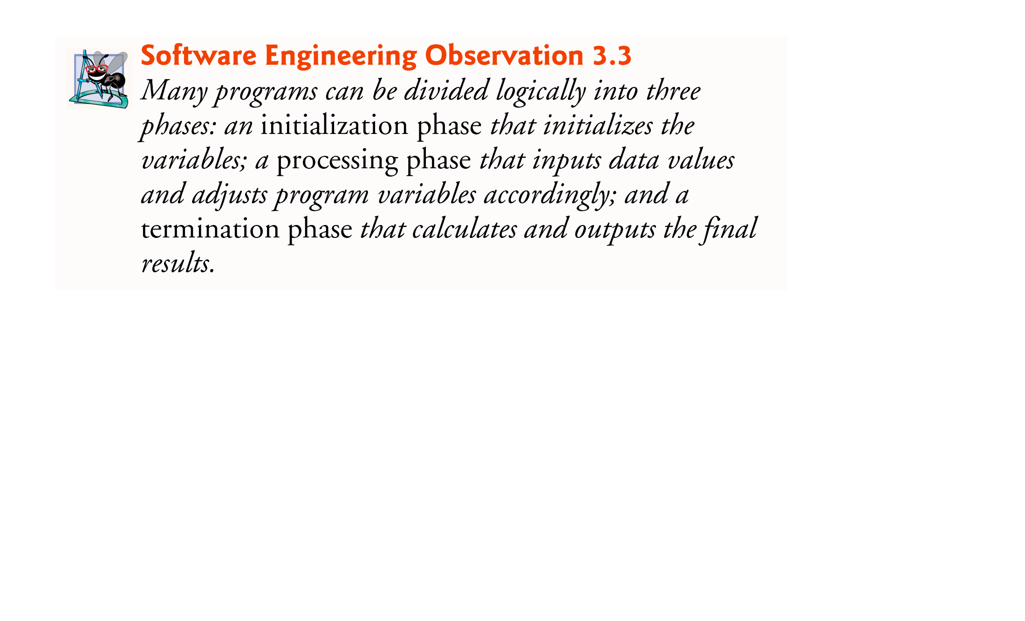

Slide 22
3.9 Formulating Algorithms: Sentinel-Controlled Repetition (Cont.)
Second refinement: commit to specific variables.
The pseudocode statement
Initialize variables
can be refined as follows:
Initialize total to zero
Initialize counter to zero

Slide 23
3.9 Formulating Algorithms: Sentinel-Controlled Repetition (Cont.)
The pseudocode statement
Input, sum and count the quiz grades
requires a repetition to successively input each grade.
We do not know in advance how many grades will be entered, so we’ll use sentinel-controlled repetition.
The second refinement of the preceding pseudocode statement is then
Prompt the user to enter the first grade Input the first grade (possibly the sentinel)
While the user has not yet entered the sentinel Add this grade into the running total Add one to the grade counter Prompt the user to enter the next grade Input the next grade (possibly the sentinel)

Slide 24
3.9 Formulating Algorithms: Sentinel-Controlled Repetition (Cont.)
The pseudocode statement
Calculate and print the class average
can be refined as follows:
If the counter is not equal to zero Set the average to the total divided by the counter Print the average else Print “No grades were entered”
Test for the possibility of division by zero—a logic error that, if undetected, would cause the program to fail or produce invalid output.

Slide 25

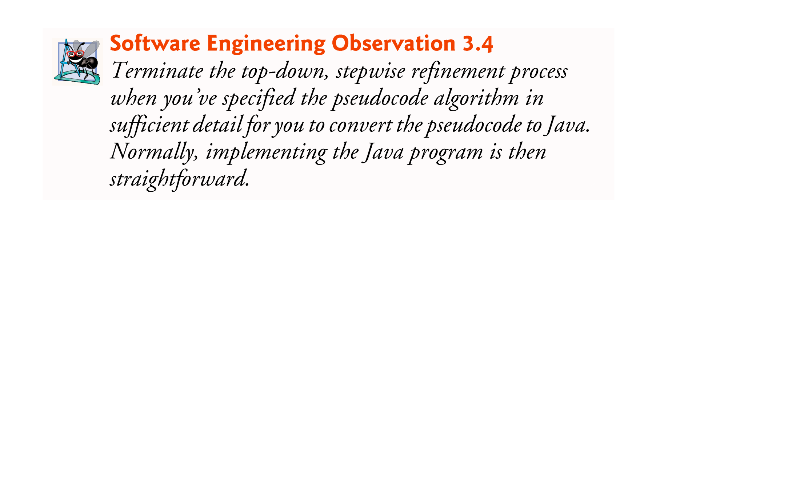

Slide 26
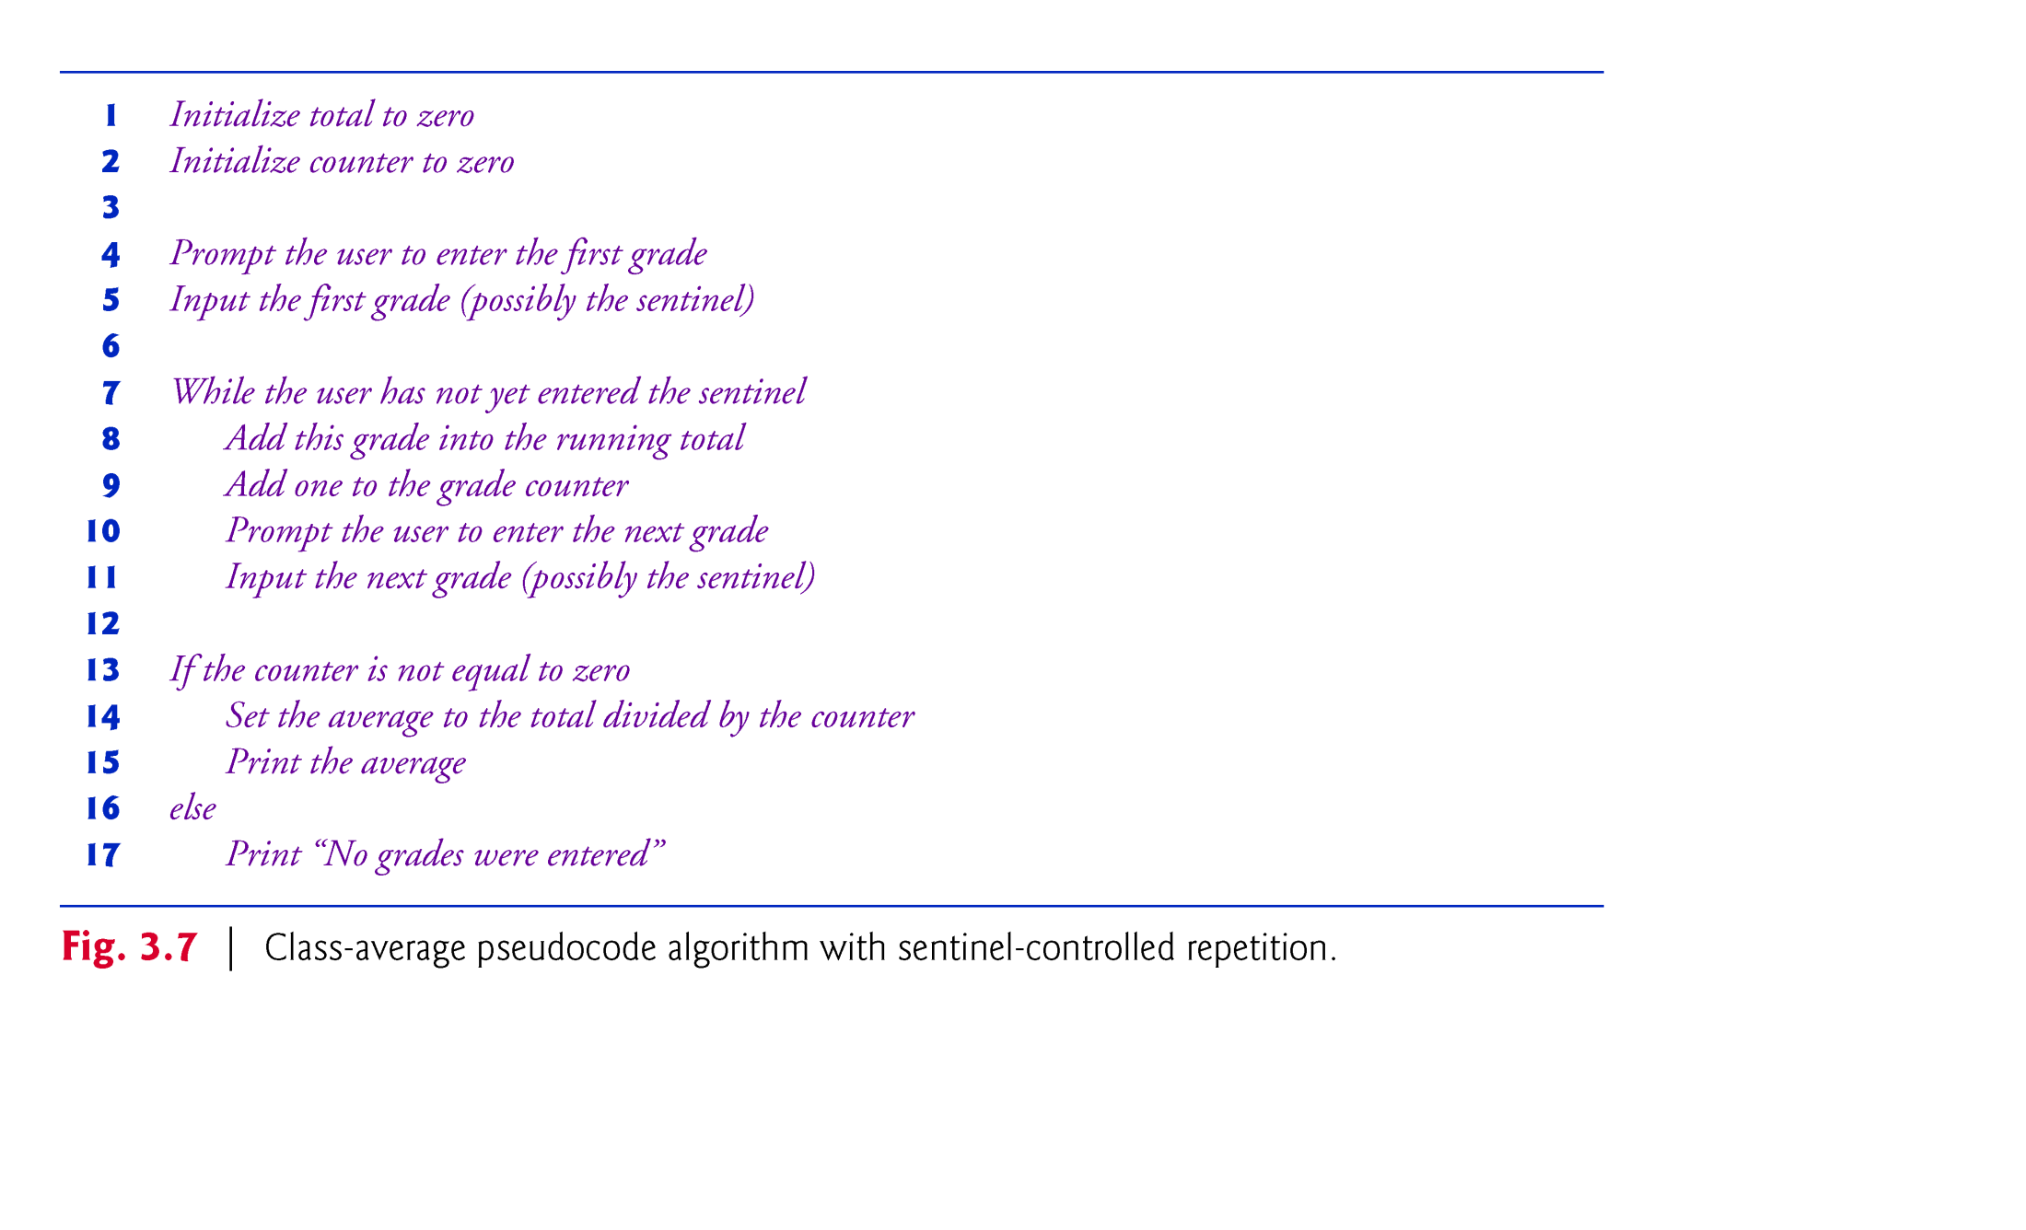

Slide 27
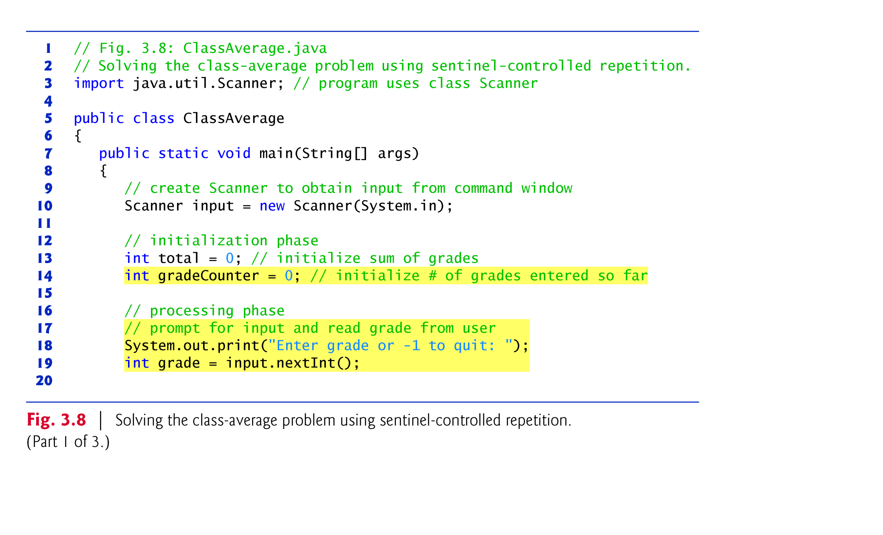

Slide 28
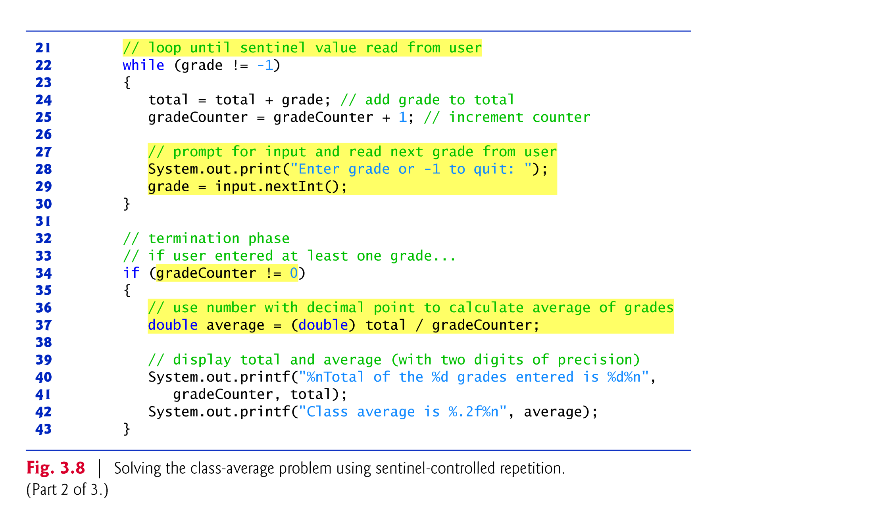

Slide 29
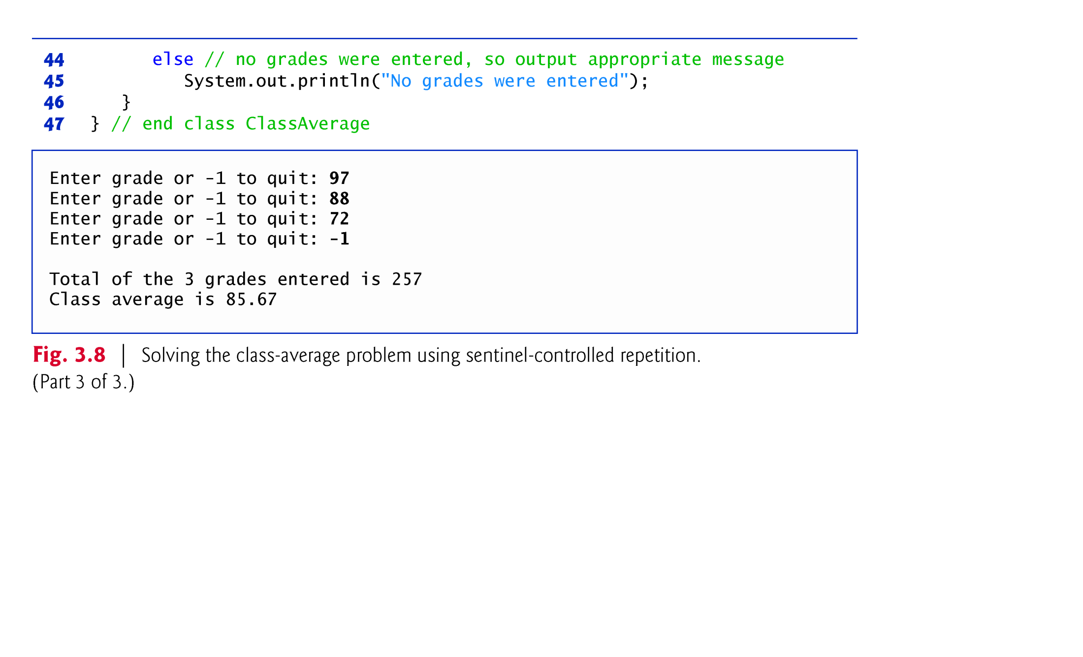

Slide 30
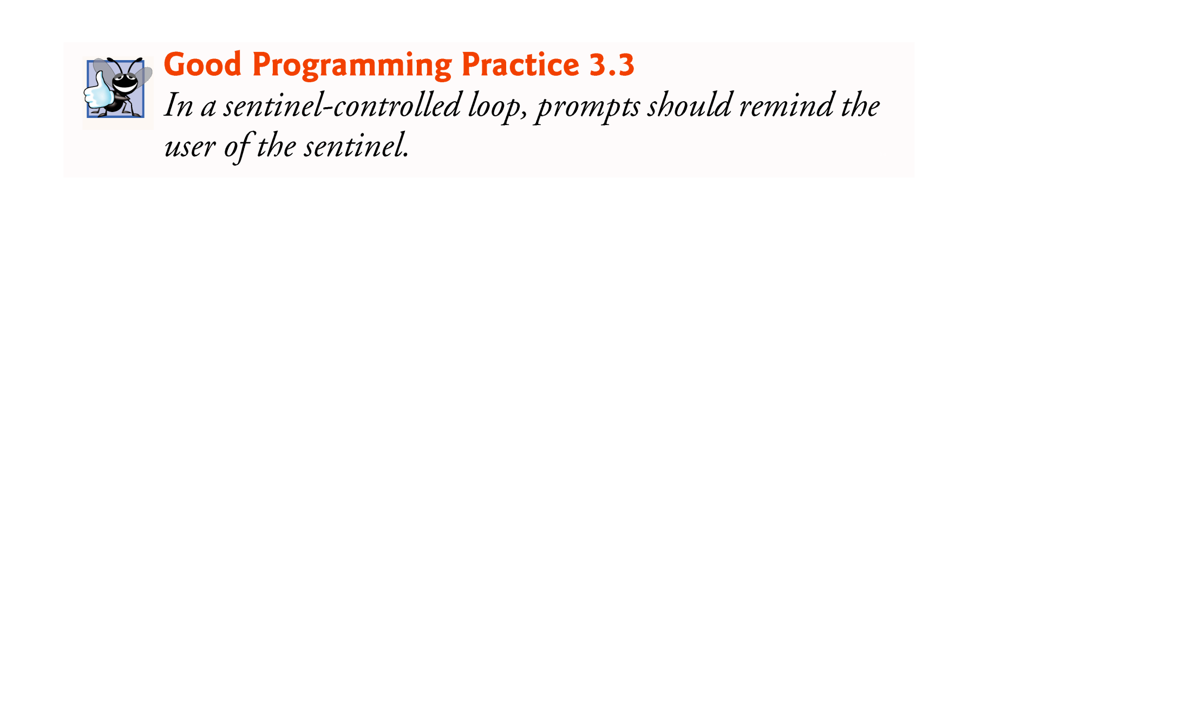
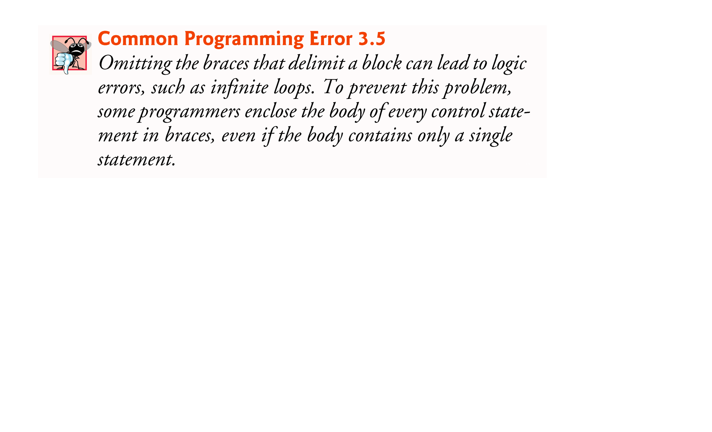

Slide 31
3.9 Formulating Algorithms: Sentinel-Controlled Repetition (Cont.)
Most averages are not whole numbers (e.g., 0, –22 and 1024).
For this reason, we calculate the class average in this example as a floating-point number.
The unary cast operator (double) creates a temporary floating-point copy of its operand.
Cast operator performs explicit conversion (or type casting).
The value stored in the operand is unchanged.
Java can evaluate only arithmetic expressions in which the operands’ types are identical.
Promotion (or implicit conversion) performed on operands.
In an expression containing values of the types int and double, the int values are promoted to double values for use in the expression.

Slide 32


Slide 33
3.9 Formulating Algorithms: Sentinel-Controlled Repetition (Cont.)
Floating-Point Number Precision
Floating-point numbers are not always 100% precise, but they have numerous applications.
For example, when we speak of a “normal” body temperature of 98.6, we do not need to be precise to a large number of digits.
When we read the temperature on a thermometer as 98.6, it may actually be 98.5999473210643.
Calling this number simply 98.6 is fine for most applications involving body temperatures.

Slide 34
3.10 Formulating Algorithms: Nested Control Statements
This case study examines nesting one control statement within another.
A college offers a course that prepares students for the state licensing exam for real-estate brokers. Last year, ten of the students who completed this course took the exam. The college wants to know how well its students did on the exam. You’ve been asked to write a program to summarize the results. You’ve been given a list of these 10 students. Next to each name is written a 1 if the student passed the exam or a 2 if the student failed.

Slide 35
3.10 Formulating Algorithms: Nested Control Statements (Cont.)
This case study examines nesting one control statement within another.
Your program should analyze the results of the exam as follows:
Input each test result (i.e., a 1 or a 2). Display the message “Enter result” on the screen each time the program requests another test result.
Count the number of test results of each type.
Display a summary of the test results, indicating the number of students who passed and the number who failed.
If more than eight students passed the exam, print “Bonus to instructor!”

Slide 36
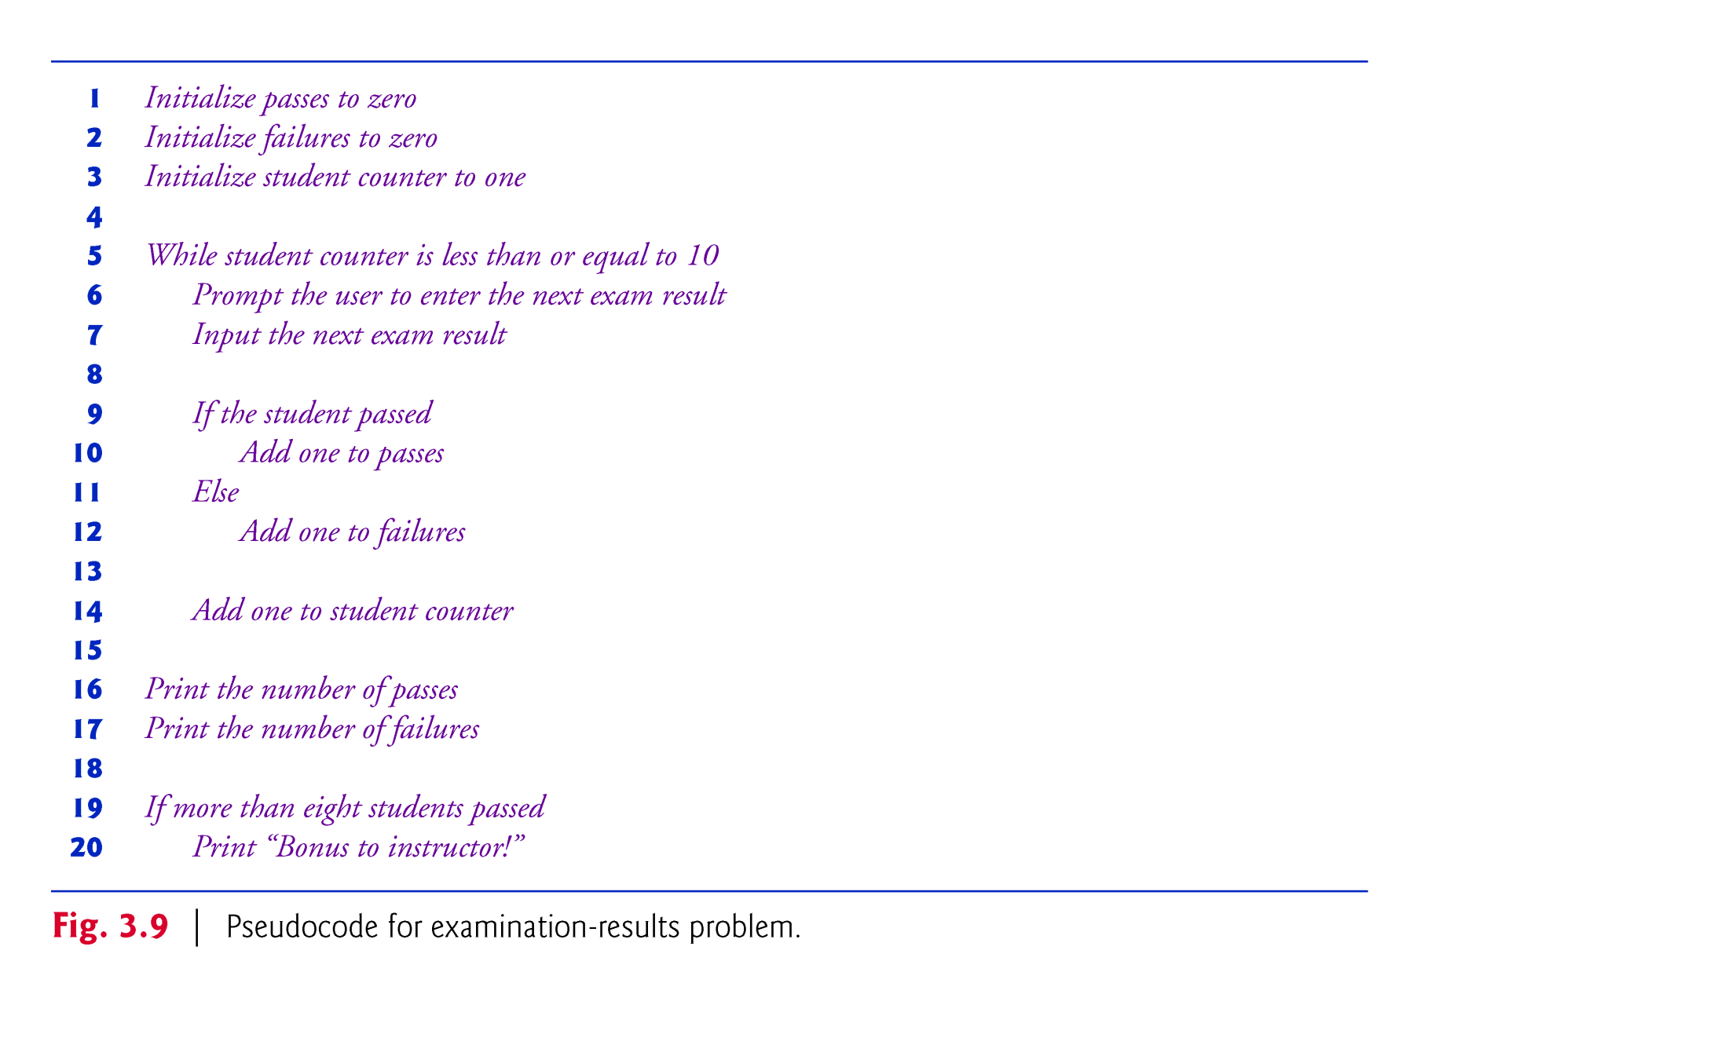

Slide 37
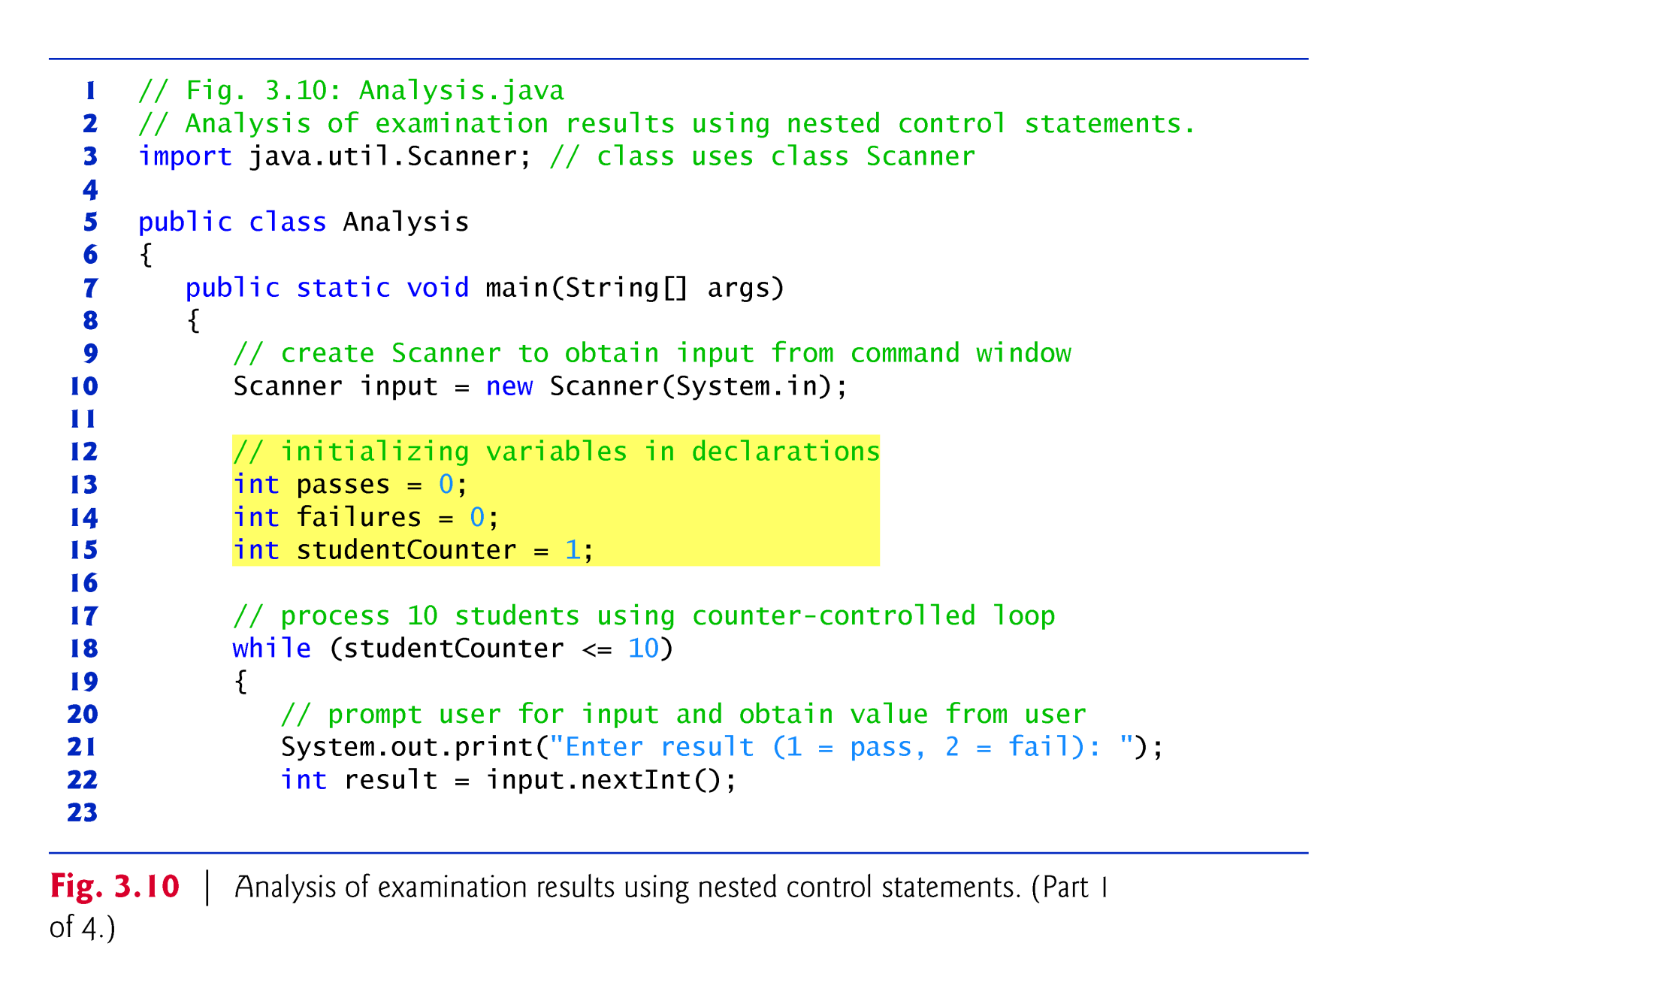

Slide 38
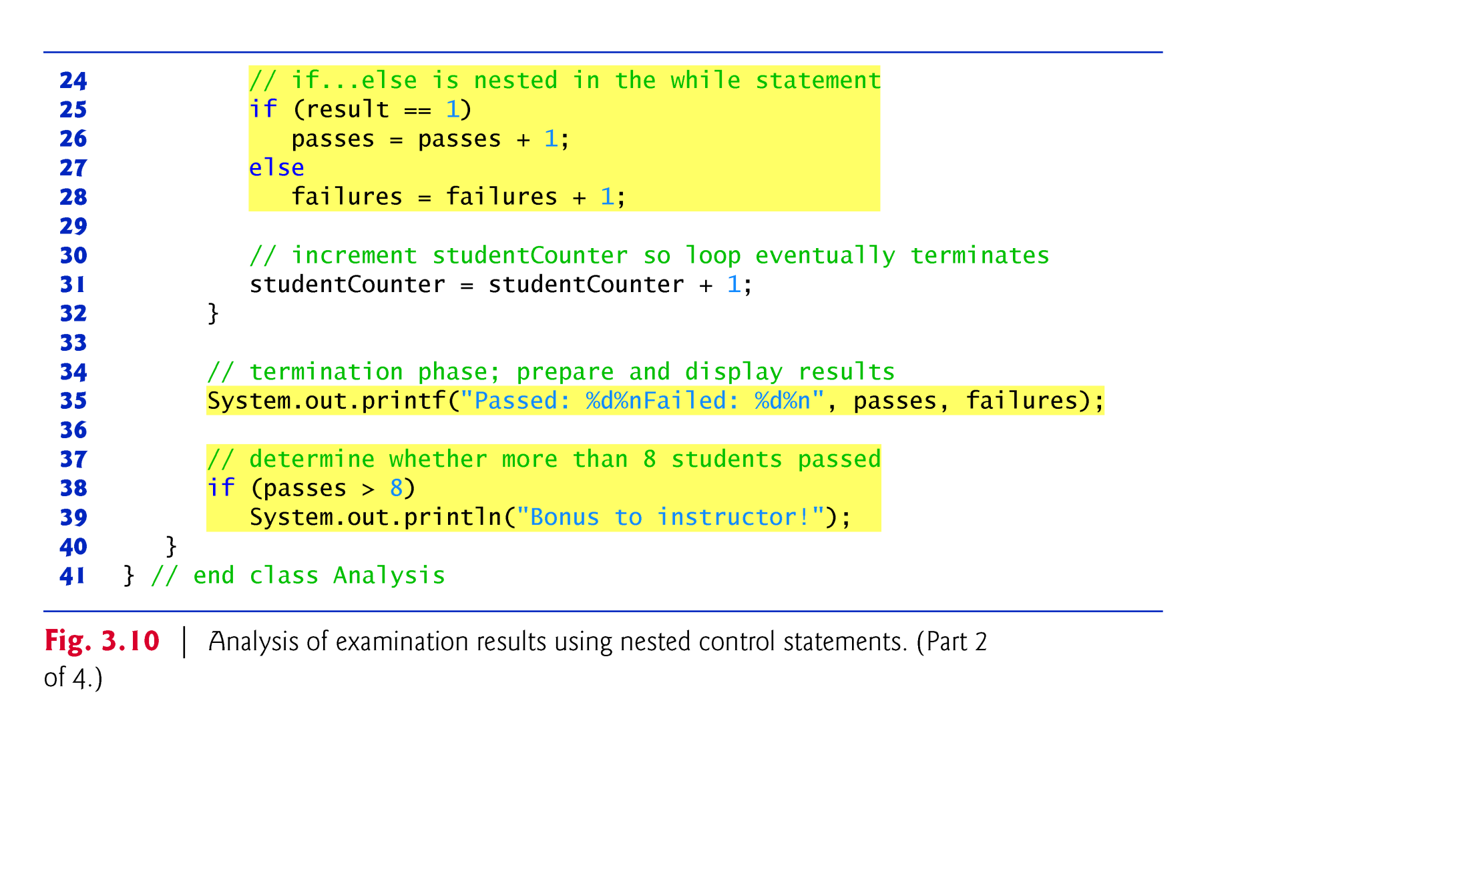

Slide 39
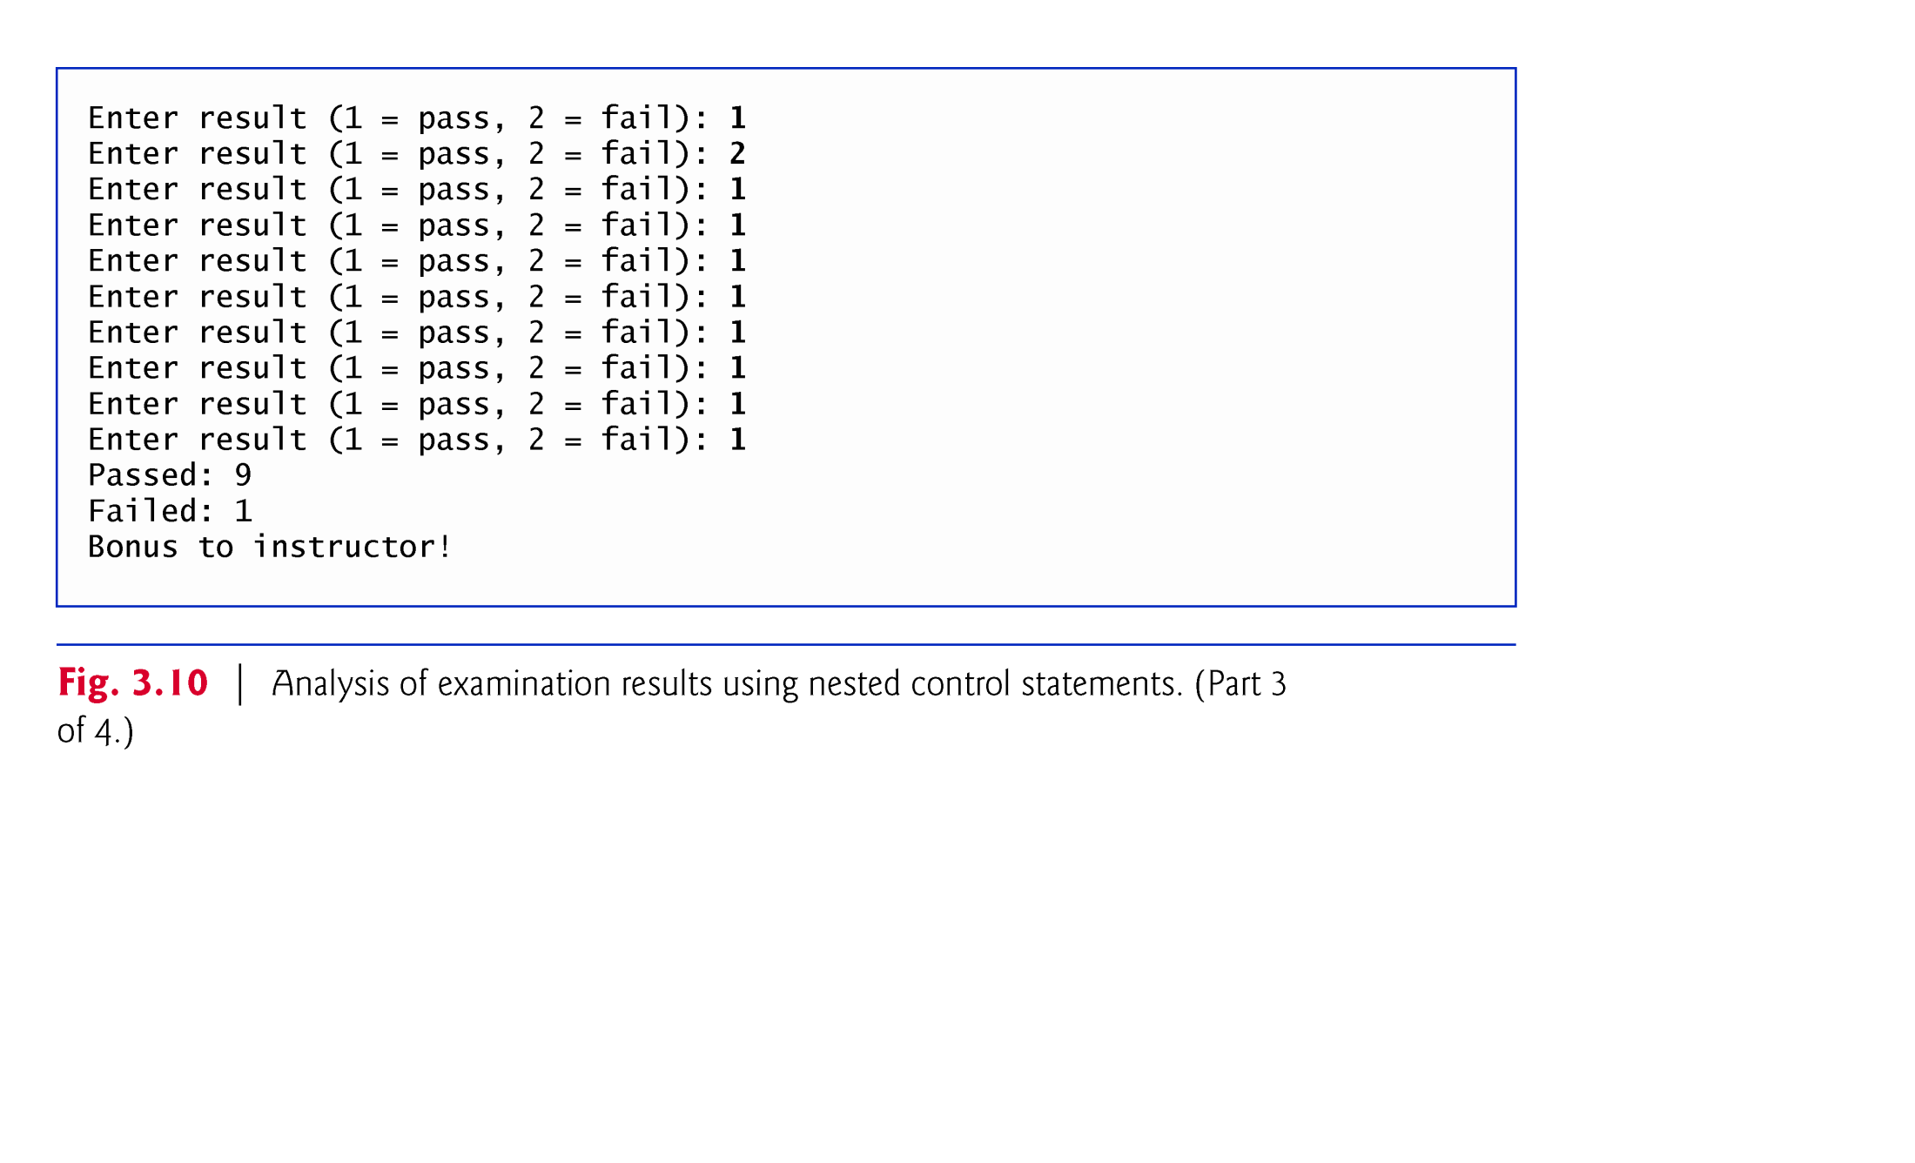
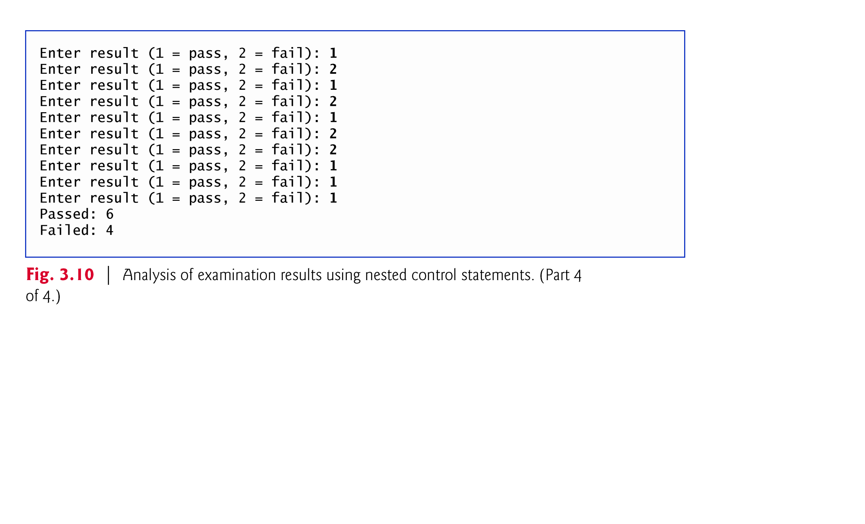

Slide 40
4.2 Essentials of Counter-Controlled Repetition
Counter-controlled repetition requires
a control variable (or loop counter)
the initial value of the control variable
the increment by which the control variable is modified each time through the loop (also known as each iteration of the loop)
the loop-continuation condition that determines if looping should continue.

Slide 41
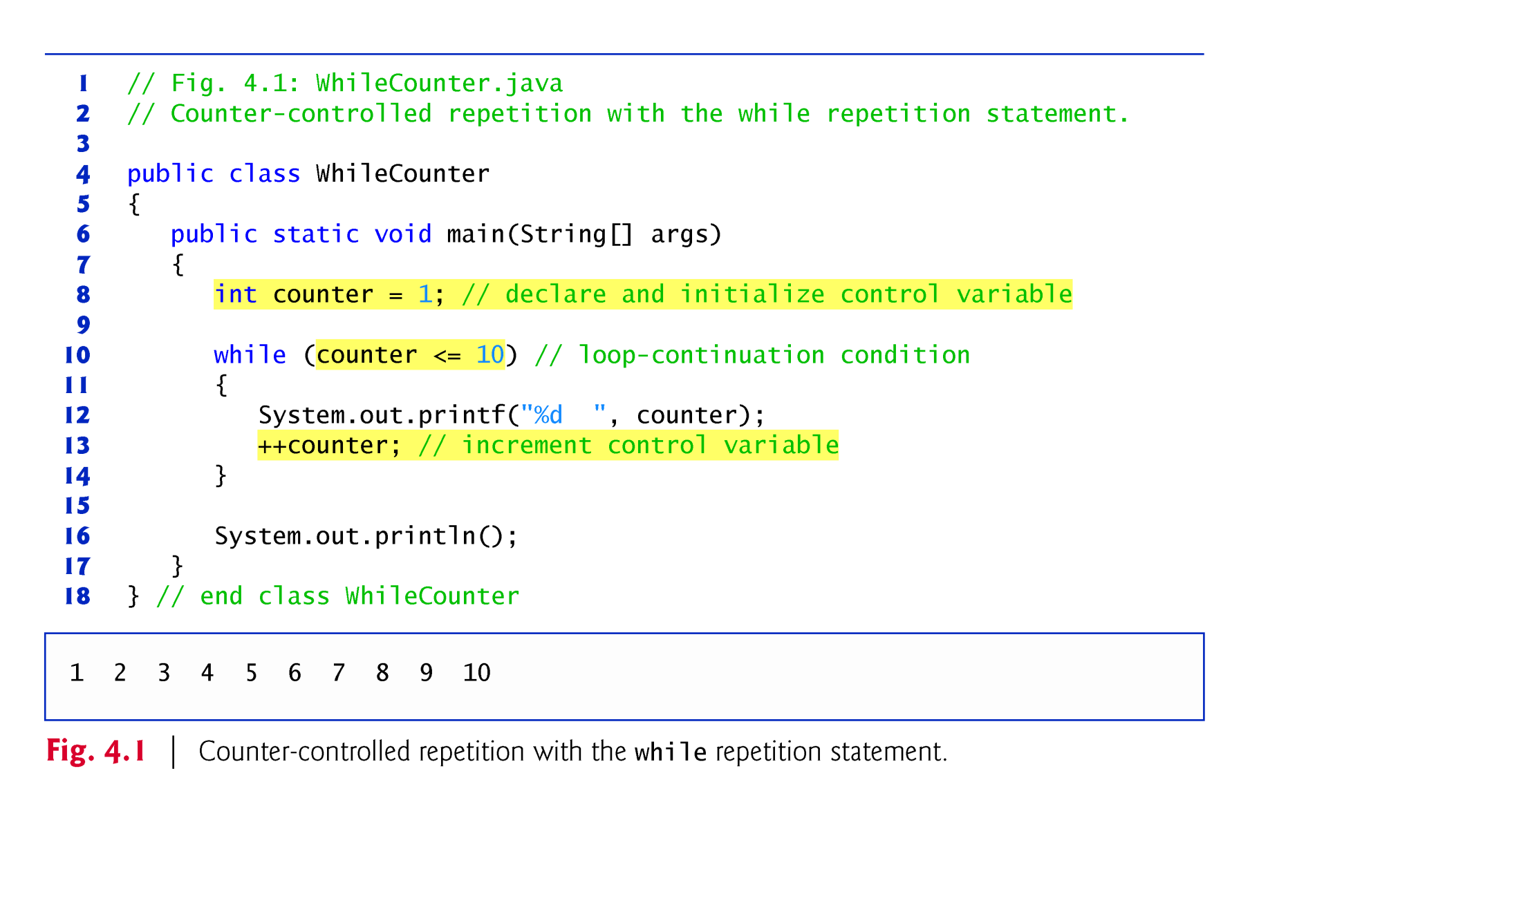
Notes:
In Fig. 4.1, the elements of counter-controlled repetition are defined in lines 8, 10 and 13.
Line 8 declares the control variable (counter) as an int, reserves space for it in memory and sets its initial value to 1.
The loop-continuation condition in the while (line 10) tests whether the value of the control variable is less than or equal to 10 (the final value for which the condition is true).
Line 13 increments the control variable by 1 for each iteration of the loop.

Slide 42
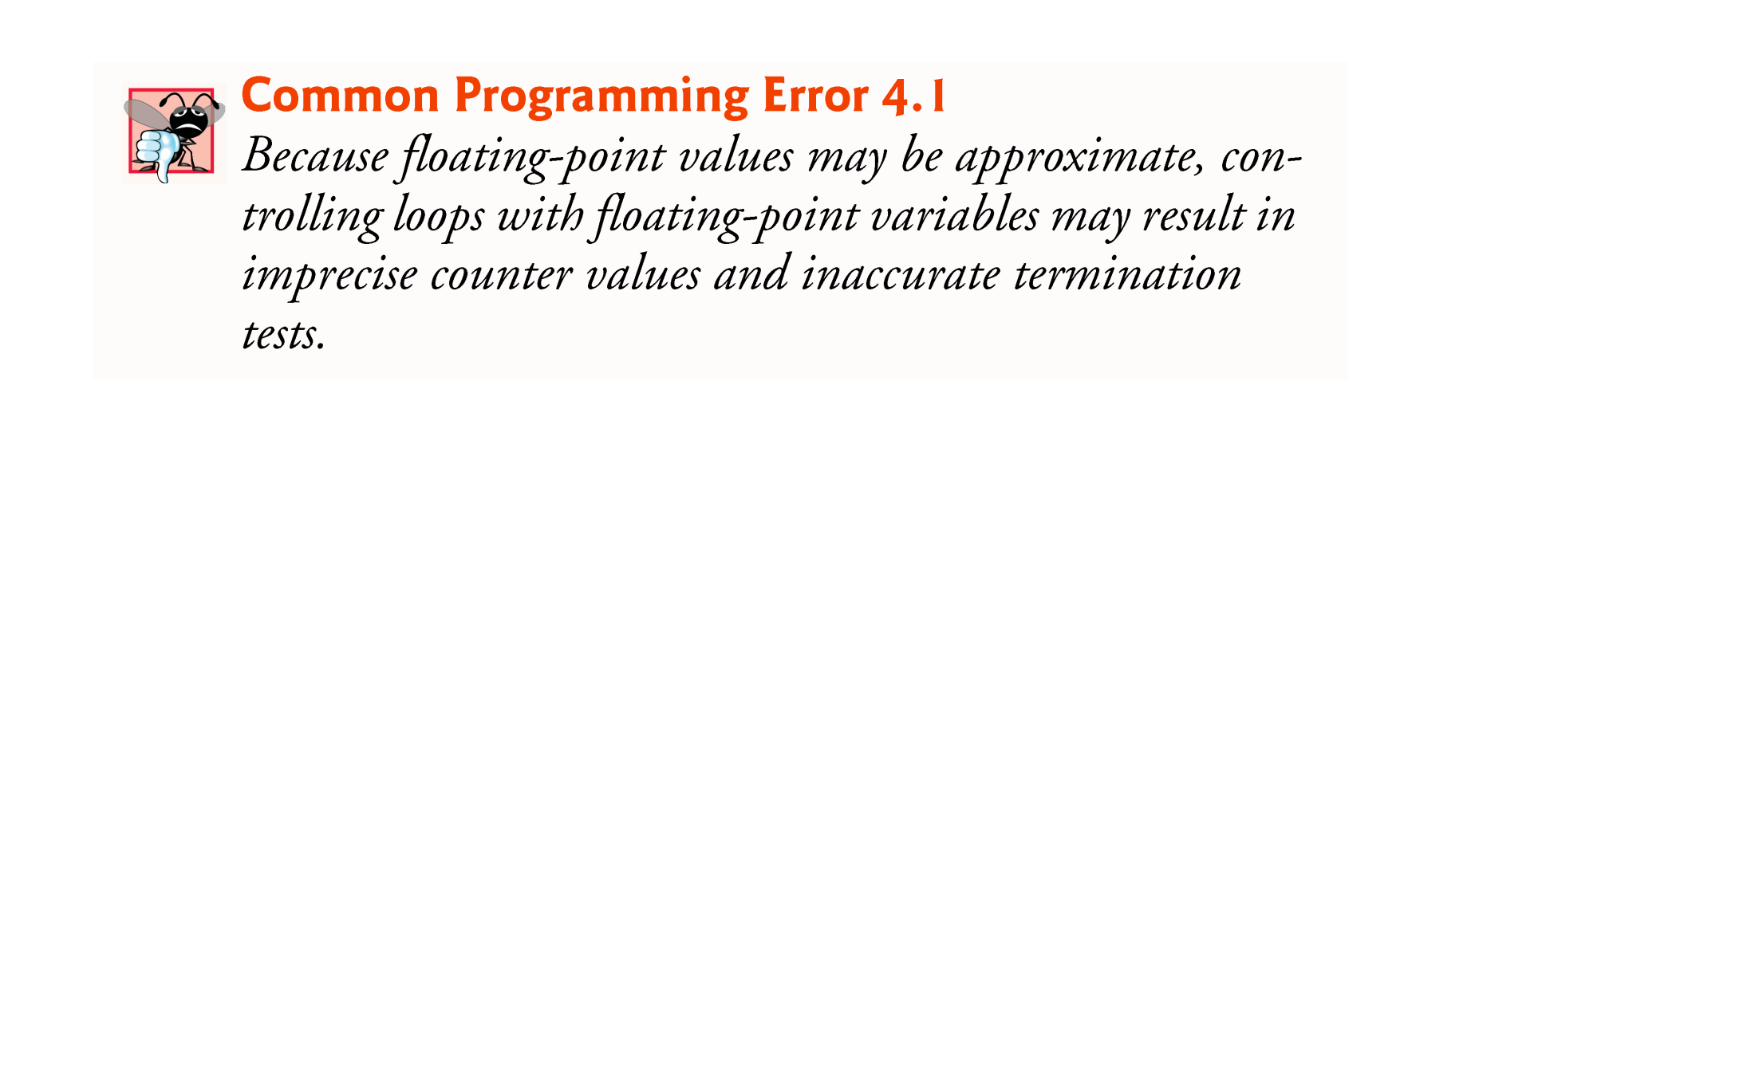
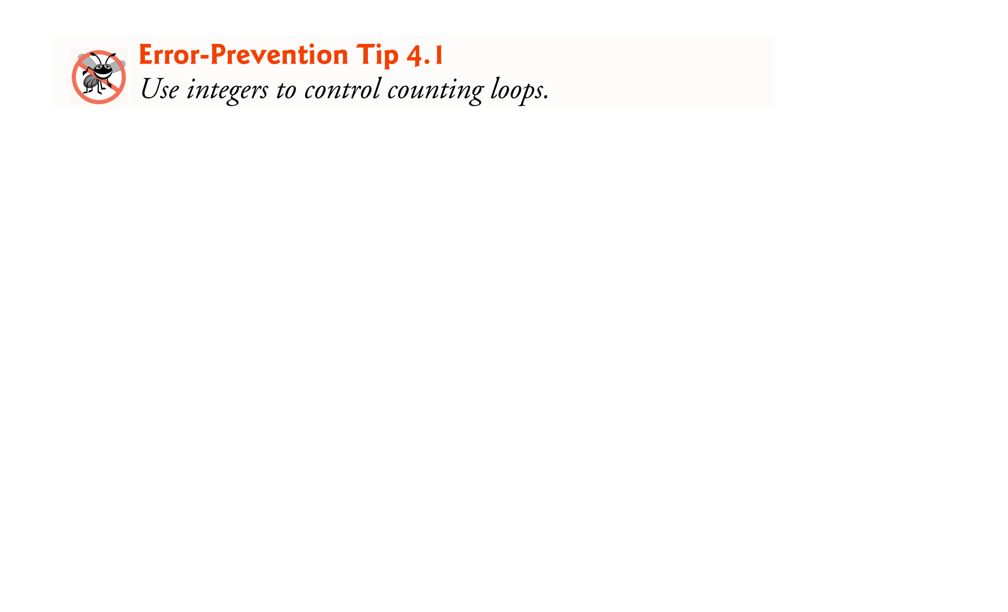
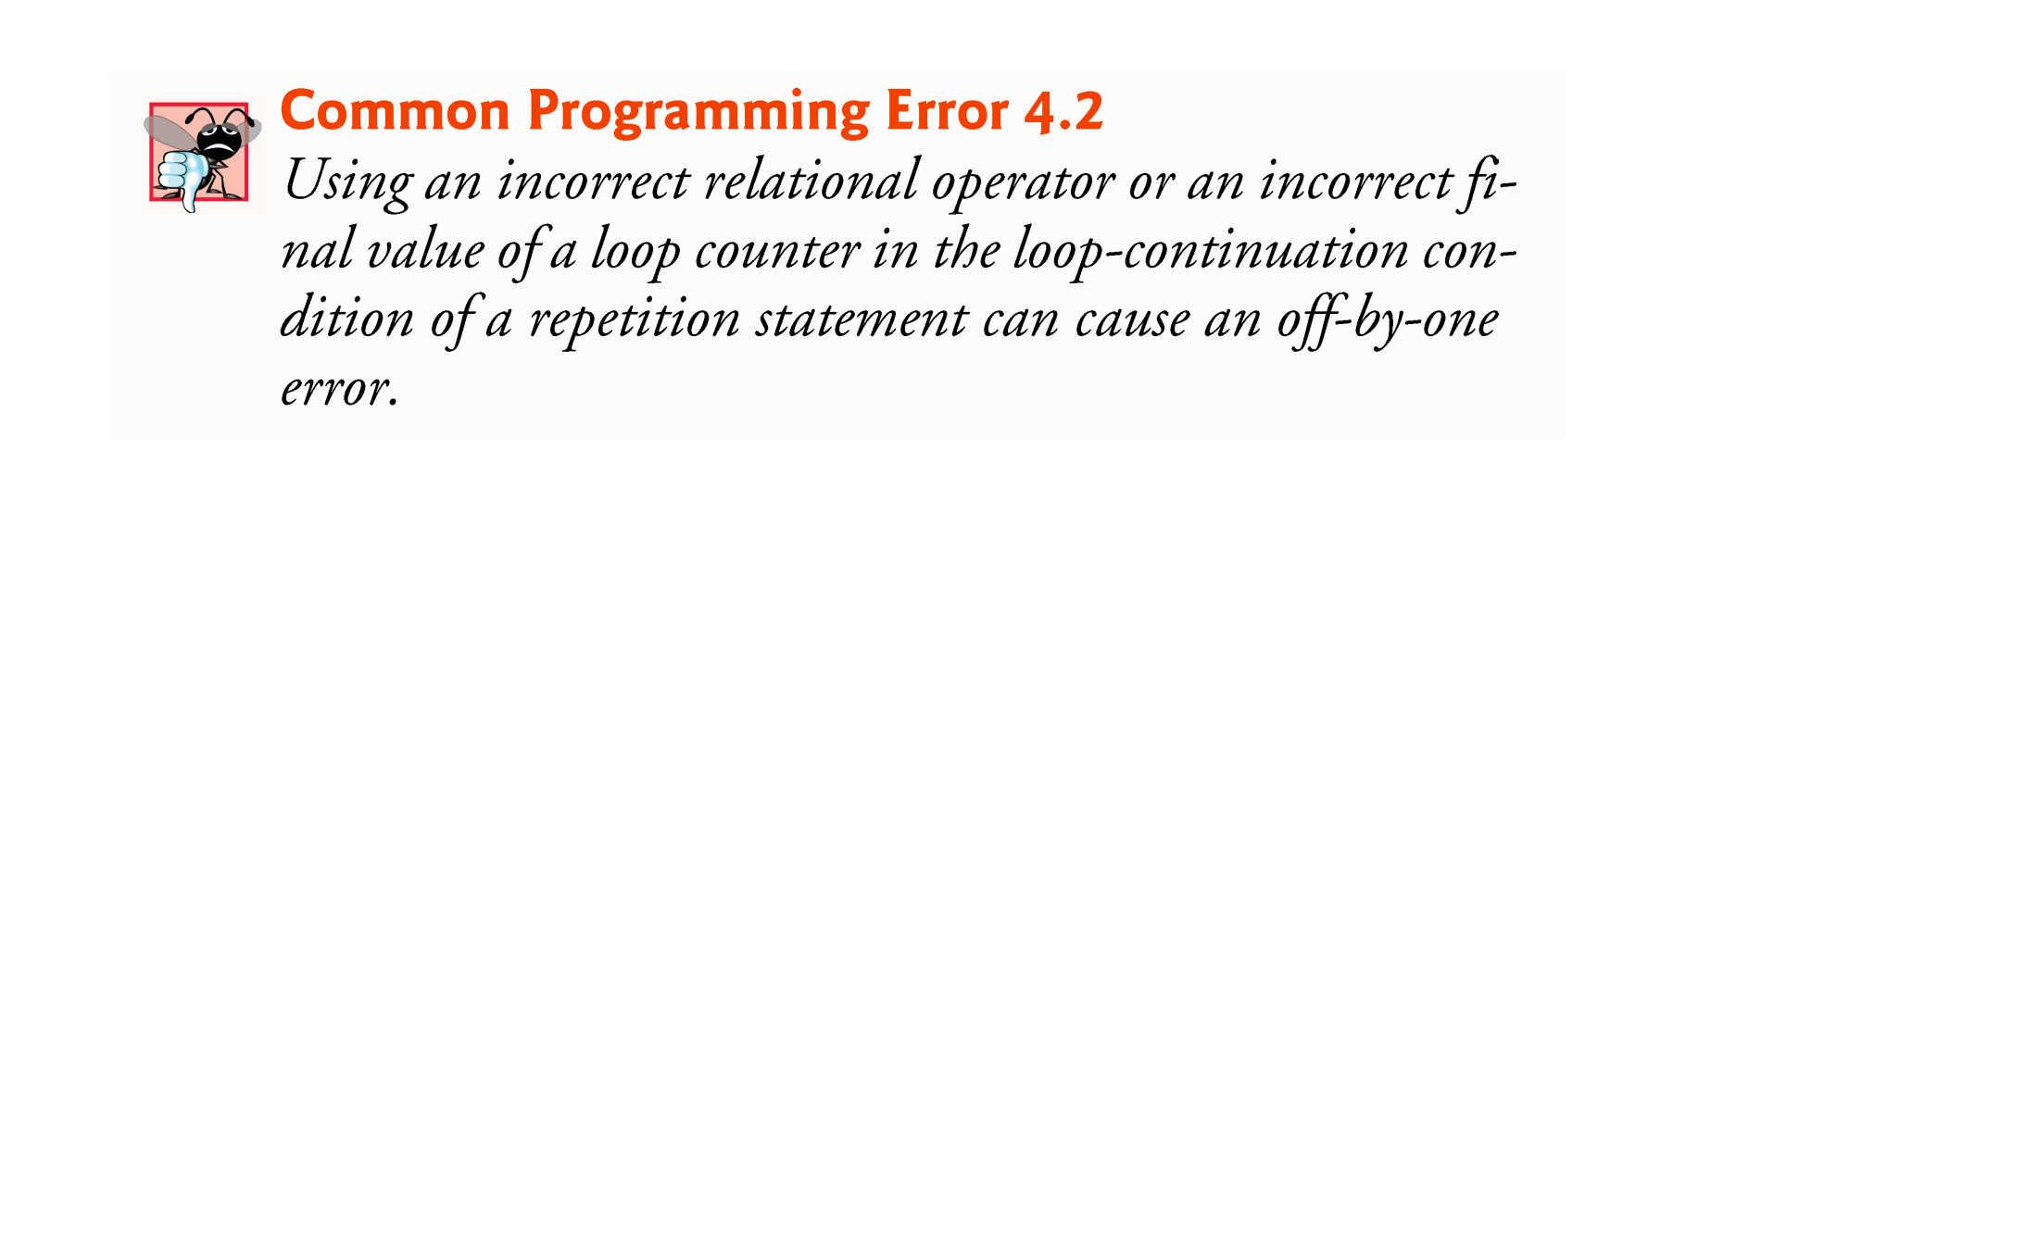

Slide 43
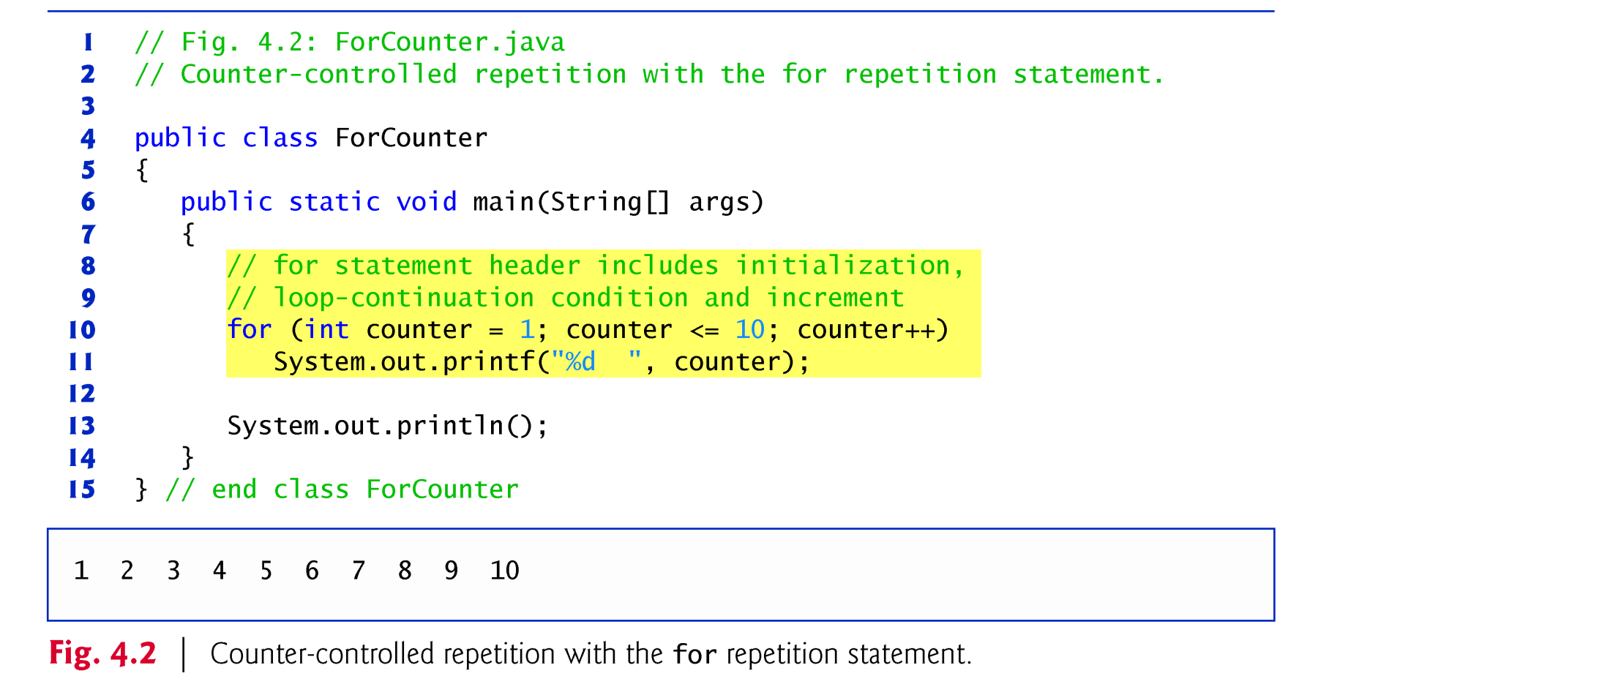
4.3 for Repetition Statement
for repetition statement
Specifies the counter-controlled-repetition details in a single line of code.
Figure 4.2 reimplements the application of Fig. 4.1 using for.

Slide 44
for (int counter = 1; counter <= 3; counter++)
1 time
4 times
3 times
Statement | Performed Action
int counter = 1; | counter declared and initialized to 1
counter <= 3; | for condition evaluated to true (1<=3)
counter++ | counter value changed to 2
counter <= 3; | condition evaluated to true (2<=3)
counter++ | product value changed to 3
counter <= 3; | condition evaluated to true (3<=3)
counter++ | product value changed to 4
counter <= 3; | condition evaluated to false (4 > 3)
Enters the loop
Notes:
When the for statement begins executing, the control variable is declared and initialized.
Next, the program checks the loop-continuation condition, which is between the two required semicolons.
If the condition initially is true, the body statement executes.
After executing the loop’s body, the program increments the control variable in the increment expression, which appears to the right of the second semicolon.
Then the loop-continuation test is performed again to determine whether the program should continue with the next iteration of the loop.
A common logic error with counter-controlled repetition is an off-by-one error.

Slide 45
4.3 for Repetition Statement (Cont.)
The general format of the for statement is
for (initialization; loopContinuationCondition; increment) statement
the initialization expression names the loop’s control variable and optionally provides its initial value
loopContinuationCondition determines whether the loop should continue executing
increment modifies the control variable’s value, so that the loop-continuation condition eventually becomes false.
The two semicolons in the for header are required.
If the loop-continuation condition is initially false, the program does not execute the for statement’s body. Instead, execution proceeds with the statement following the for.

Slide 46
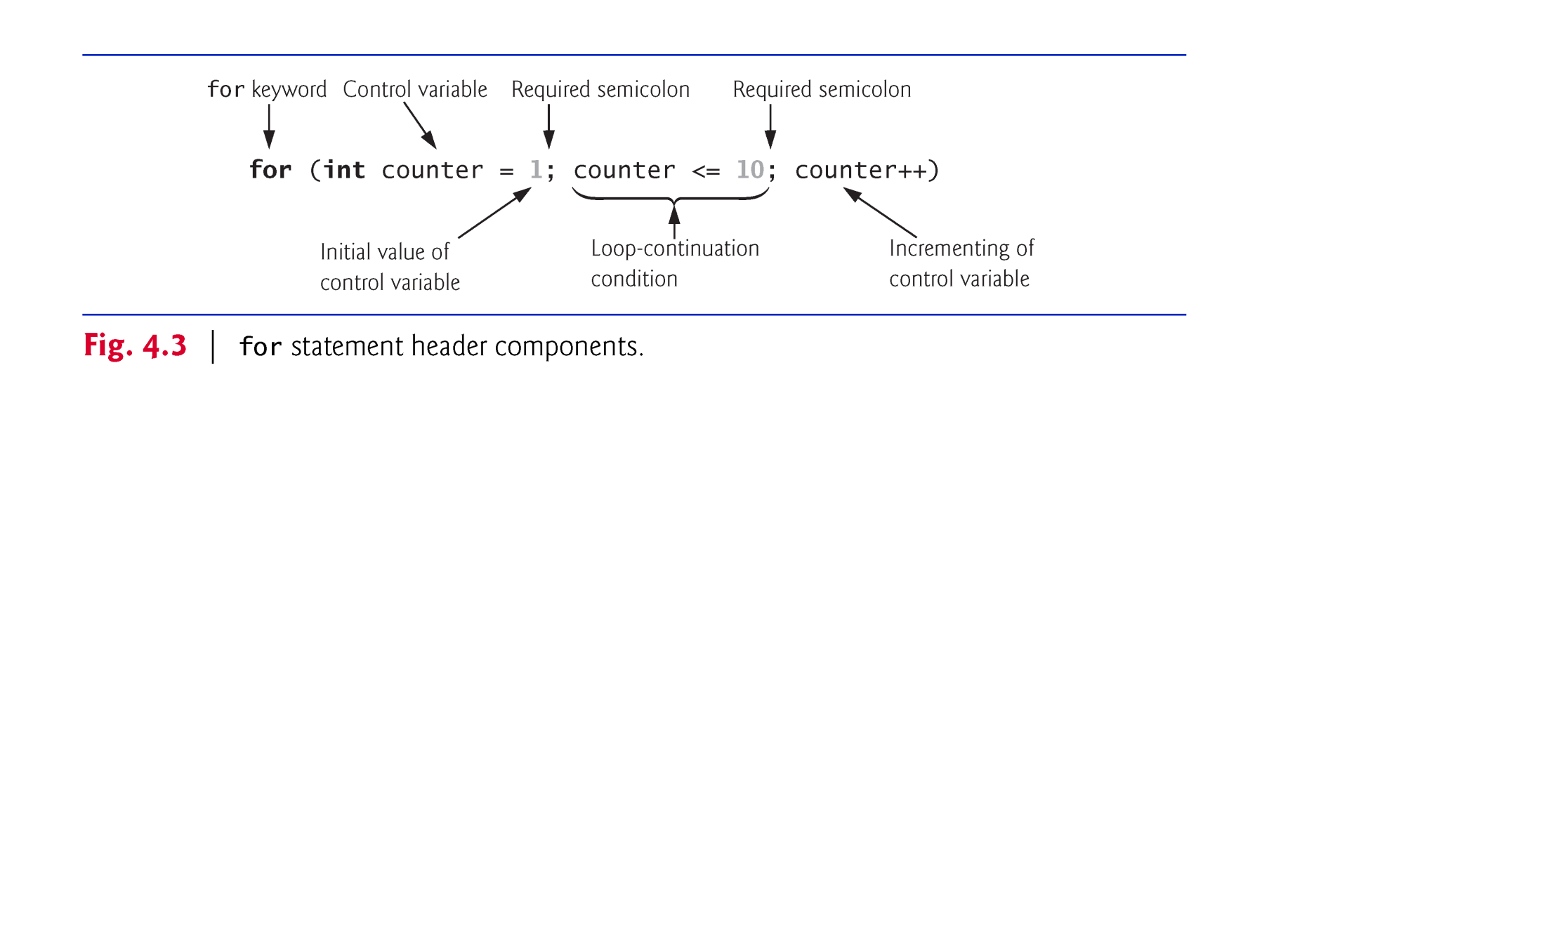

Slide 47
4.3 for Repetition Statement (Cont.)
The for statement often can be represented with an equivalent while statement as follows:
initialization;
while (loopContinuationCondition) { statement increment; }
Typically, for statements are used for counter-controlled repetition and while statements for sentinel-controlled repetition.
If the initialization expression in the for header declares the control variable, the control variable can be used only in that for statement.

Slide 48



Slide 49
4.3 for Repetition Statement (Cont.)
All three expressions in a for header are optional.
If the loopContinuationCondition is omitted, the condition is always true, thus creating an infinite loop.
You might omit the initialization expression if the program initializes the control variable before the loop.
You might omit the increment if the program calculates it with statements in the loop’s body or if no increment is needed.
The increment expression in a for acts as if it were a standalone statement at the end of the for’s body, so
counter = counter + 1 counter += 1 ++counter counter++
are equivalent increment expressions in a for statement.

Slide 50

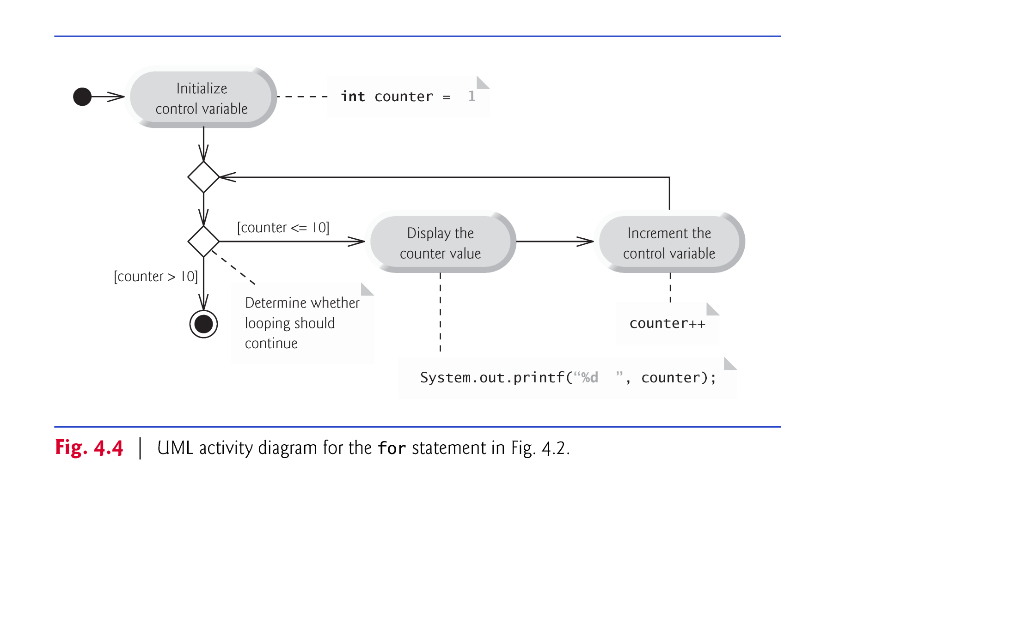

Slide 51
4.3 for Repetition Statement (Cont.)
The initialization, loop-continuation condition and increment can contain arithmetic expressions.
for (int j = x; j <= 4 * x * y; j += y / x)
The increment of a for statement may be negative, in which case it’s a decrement, and the loop counts downward.
for (int k = 10; k >= 1; k--)

Slide 52
4.4 Examples Using the for Statement
a)Vary the control variable from 1 to 100 in increments of 1.
for (int i = 1; i <= 100; i++)
b)Vary the control variable from 100 to 1 in decrements of 1.
for (int i = 100; i >= 1; i--)
c)Vary the control variable from 7 to 77 in increments of 7.
for (int i = 7; i <= 77; i += 7)

Slide 53
4.4 Examples Using the for Statement (Cont.)
d)Vary the control variable from 20 to 2 in decrements of 2.
for (int i = 20; i >= 2; i -= 2)
e)Vary the control variable over the values 2, 5, 8, 11, 14, 17, 20.
for (int i = 2; i <= 20; i += 3)
f)Vary the control variable over the values 99, 88, 77, 66, 55, 44, 33, 22, 11, 0.
for (int i = 99; i >= 0; i -= 11)

Slide 54
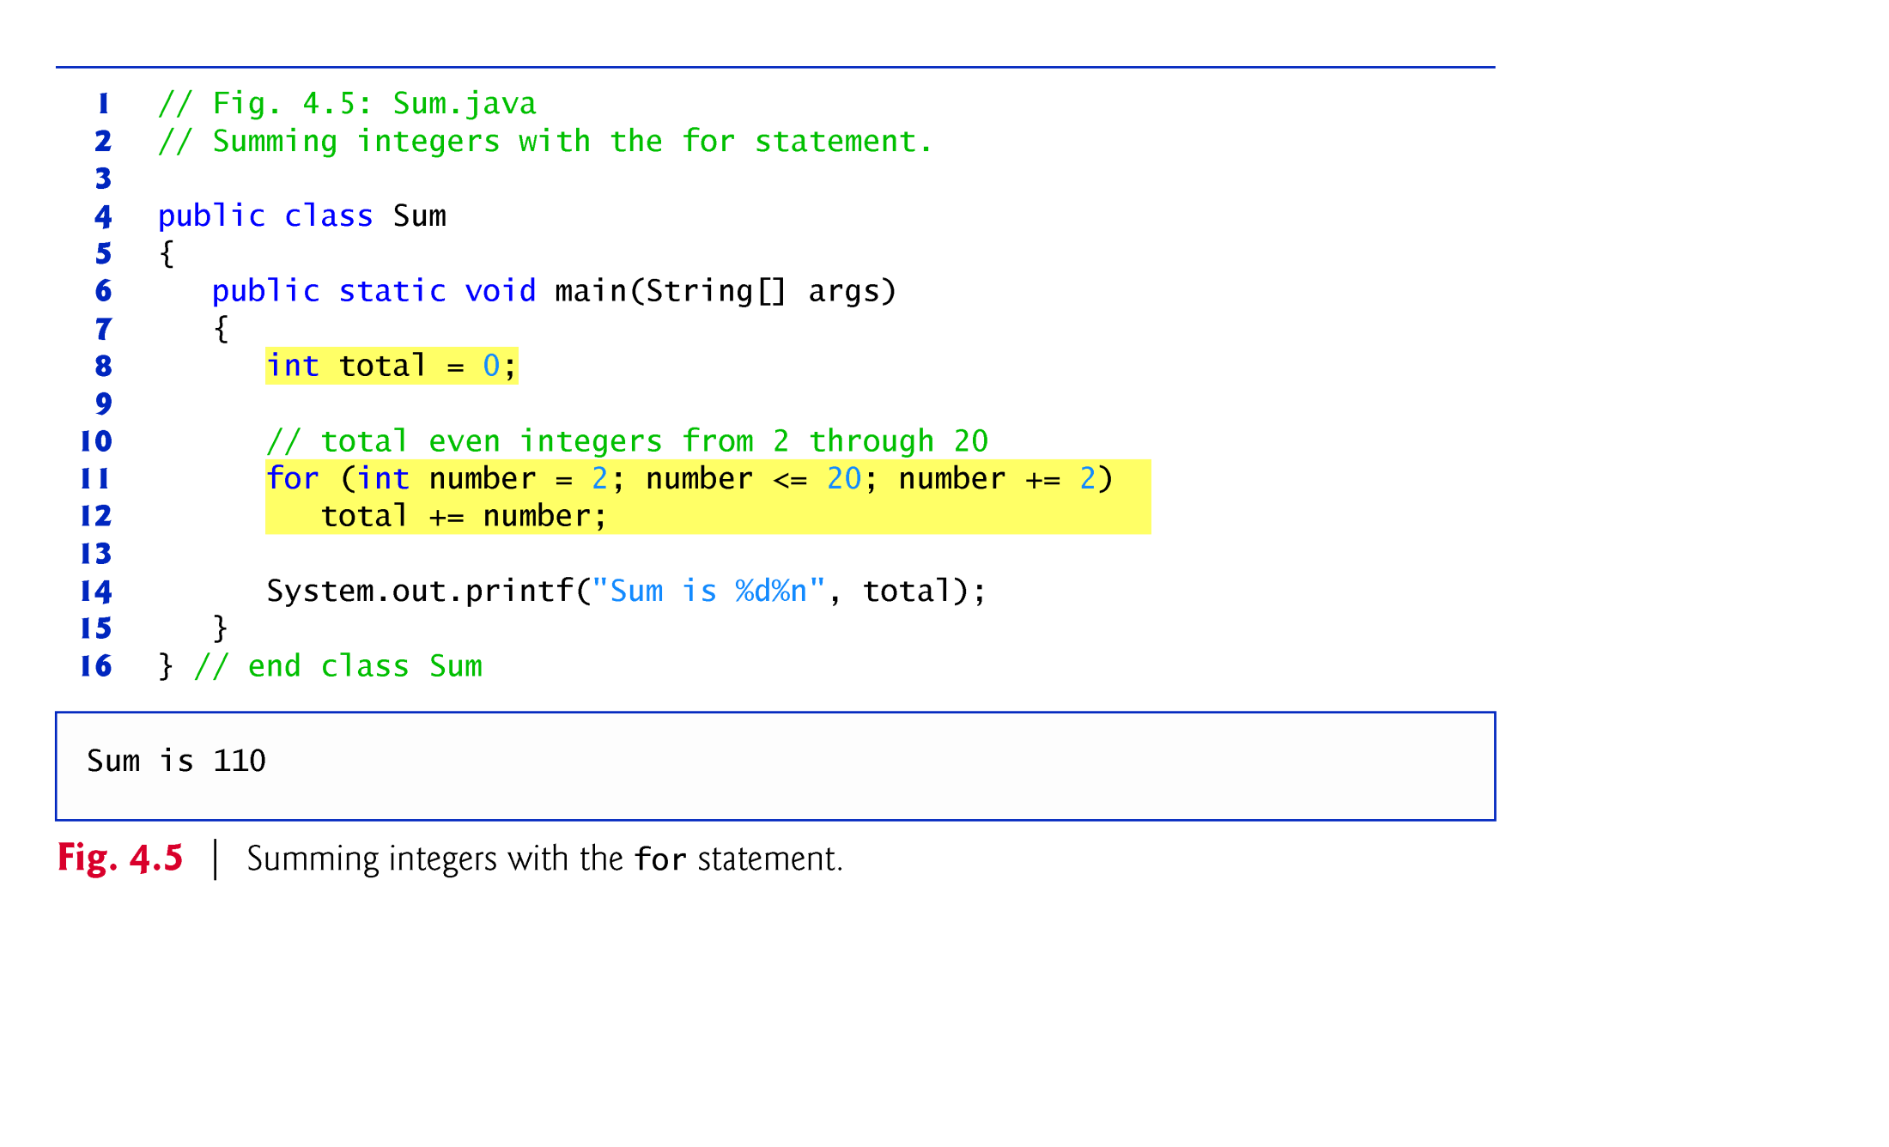

Slide 55
4.4 Examples Using the for Statement (Cont.)
The initialization and increment expressions can be comma-separated lists that enable you to use multiple initialization expressions or multiple increment expressions.
Body of the for statement could be merged into the increment portion of the for header by using a comma as follows:
for (int number = 2; number <= 20; total += number, number += 2) ; // empty statement

Slide 56
4.5 do…while Repetition Statement
The do…while repetition statement is similar to the while statement.
In the while, the program tests the loop-continuation condition at the beginning of the loop, before executing the loop’s body; if the condition is false, the body never executes.
The do…while statement tests the loop-continuation condition after executing the loop’s body; therefore, the body always executes at least once.
When a do…while statement terminates, execution continues with the next statement in sequence.

Slide 57
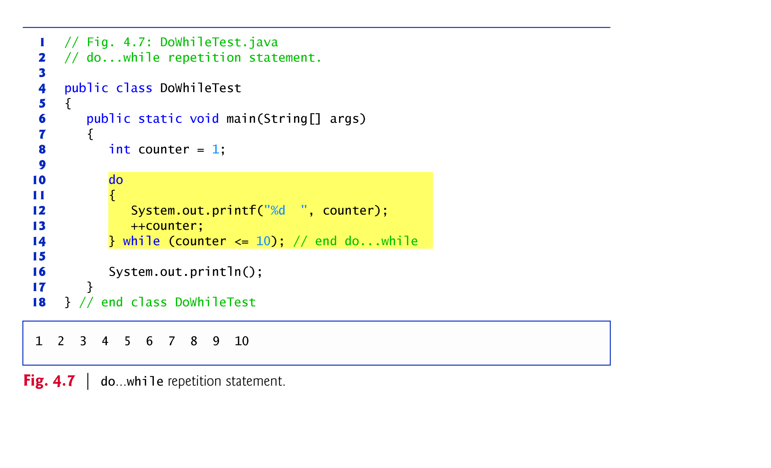

Slide 58
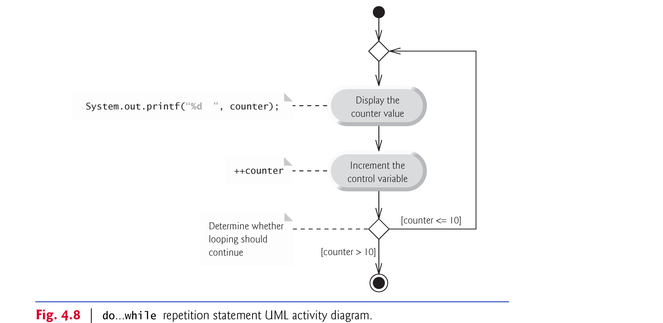
4.5 do…while Repetition Statement (Cont.)
The diagram makes it clear that the loop-continuation condition is not evaluated until after the loop performs the action state at least once.

Slide 59
4.7 break and continue Statements
The break statement, when executed in a while, for, do…while or switch, causes immediate exit from that statement.
Execution continues with the first statement after the control statement.
Common uses of the break statement are to escape early from a loop or to skip the remainder of a switch.

Slide 60
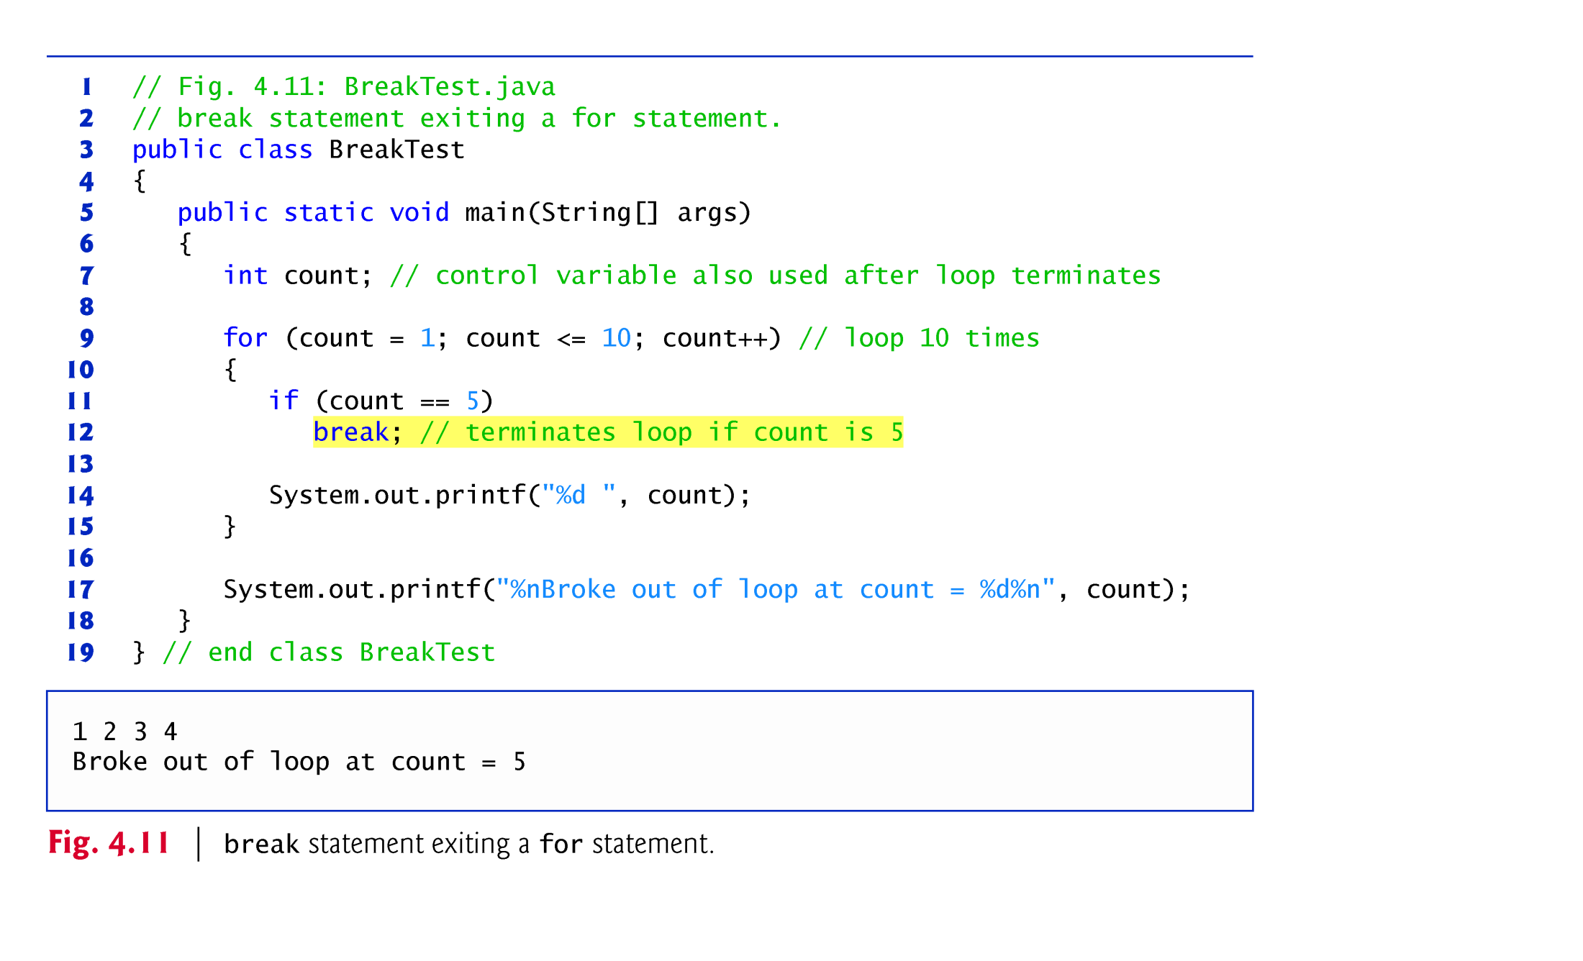

Slide 61
4.7 break and continue Statements (Cont.)
The continue statement, when executed in a while, for or do…while, skips the remaining statements in the loop body and proceeds with the next iteration of the loop.
In while and do…while statements, the program evaluates the loop-continuation test immediately after the continue statement executes.
In a for statement, the increment expression executes, then the program evaluates the loop-continuation test.

Slide 62
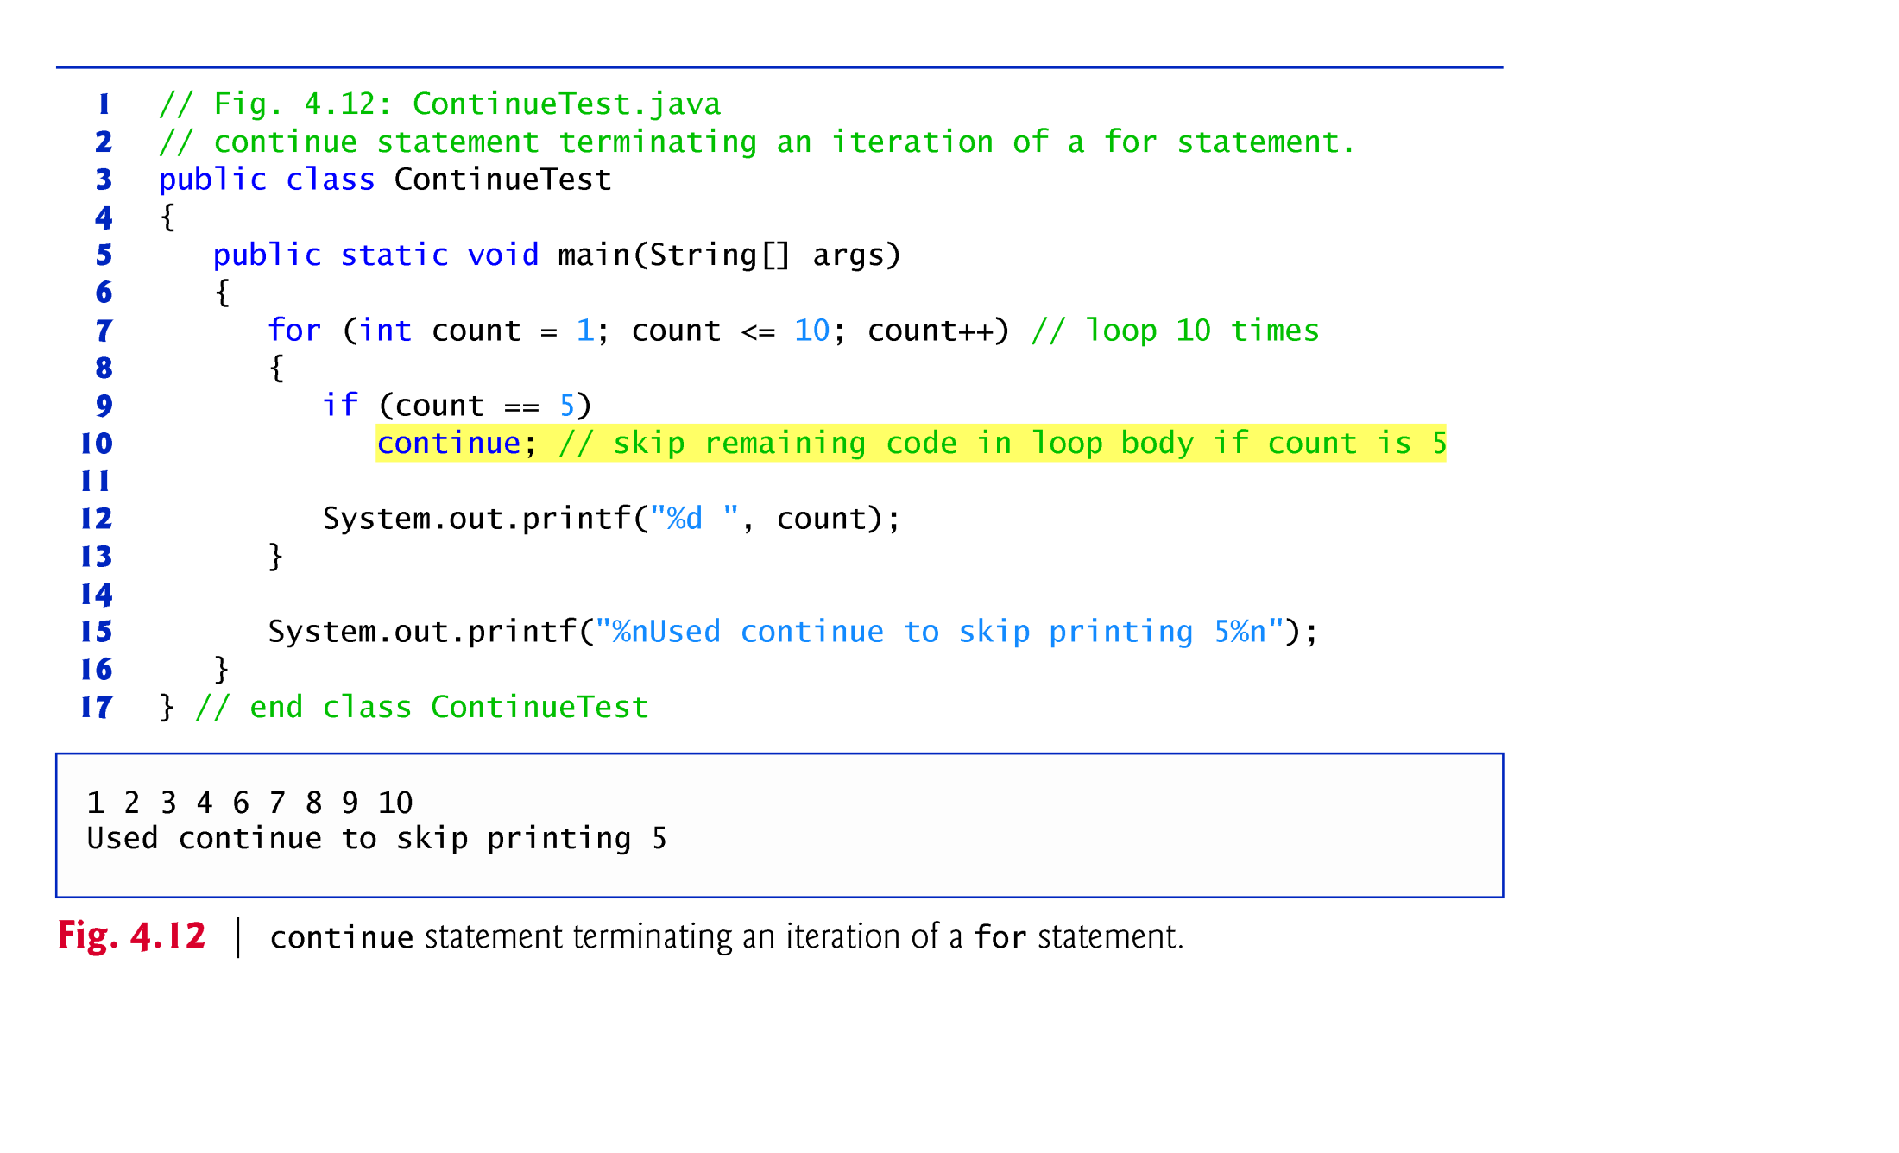

Slide 63
4.9 Structured Programming Summary
Structured programming promotes simplicity.
Only three forms of control are needed to implement an algorithm:
sequence
selection
repetition
The sequence structure is trivial. Simply list the statements to execute in the order in which they should execute.

Slide 64
4.9 Structured Programming Summary (Cont.)
Selection is implemented in one of three ways:
if statement (single selection)
if…else statement (double selection)
switch statement (multiple selection)
The simple if statement is sufficient to provide any form of selection—everything that can be done with the if…else statement and the switch statement can be implemented by combining if statements.

Slide 65
4.9 Structured Programming Summary (Cont.)
Repetition is implemented in one of three ways:
while statement
do…while statement
for statement
The while statement is sufficient to provide any form of repetition. Everything that can be done with do…while and for can be done with the while statement.

Slide 66
4.9 Structured Programming Summary (Cont.)
Combining these results illustrates that any form of control ever needed in a Java program can be expressed in terms of
sequence
if statement (selection)
while statement (repetition)
and that these can be combined in only two ways—stacking and nesting.

